Slide 1
Aligning Self-Supervised Models with Human Intents
CSCI 601-471/671 (NLP: Self-Supervised Models)
https://self-supervised.cs.jhu.edu/sp2024/

Slide 2
History Recap!

Slide 3
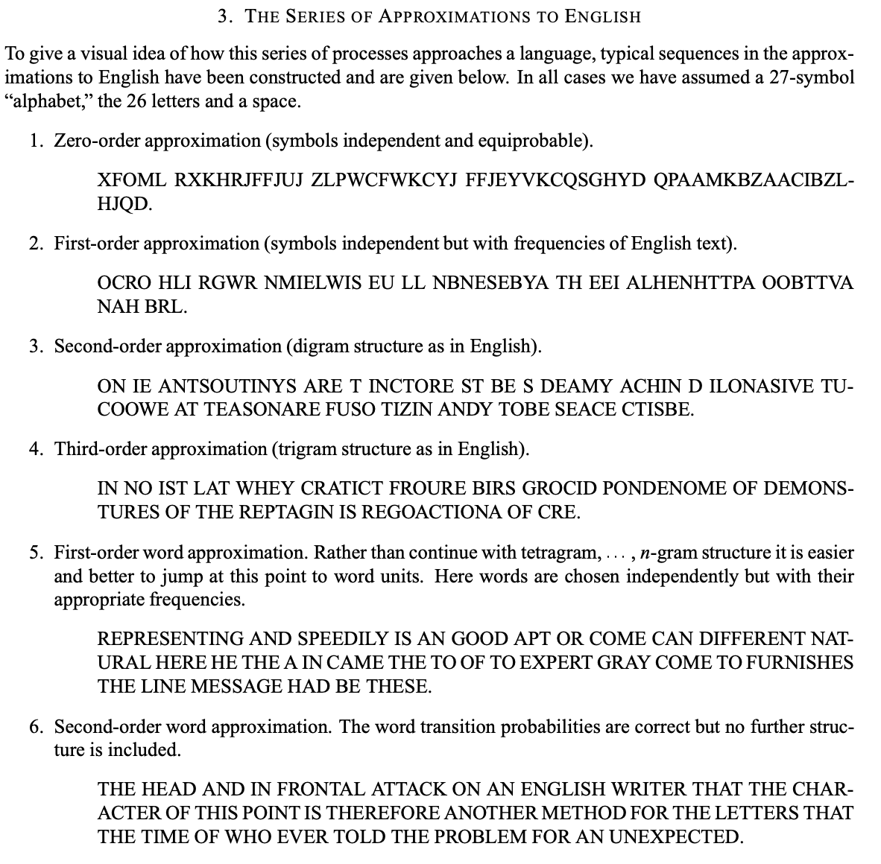
A heavily abbreviated history of LLMs
1948: Claude Shannon models English
Shannon 1948
[Slide credit: Nate Lambert]
Notes:
The basic idea for a generative process of the English language was first posited by Claude Shannon, father of information theory in 1948. Here’s an excerpt from the paper that outlines the idea. If you randomly draw “symbols”, e.g., letters (or sometimes we call these Tokens)

Slide 4

A heavily abbreviated history of LLMs
1948: Claude Shannon models English
1948-2017:
50s: the turing test
60s: ELIZA, chatbot for therapy
70s-80s: more chatbots, statistical approaches
90s-00s: language modeling
00s-10s: word embeddings
[Slide credit: Nate Lambert]
Notes:
The basic idea for a generative process of the English language was first posited by Claude Shannon, father of information theory in 1948. Here’s an excerpt from the paper that outlines the idea. If you randomly draw “symbols”, e.g., letters (or sometimes we call these Tokens)

Slide 5
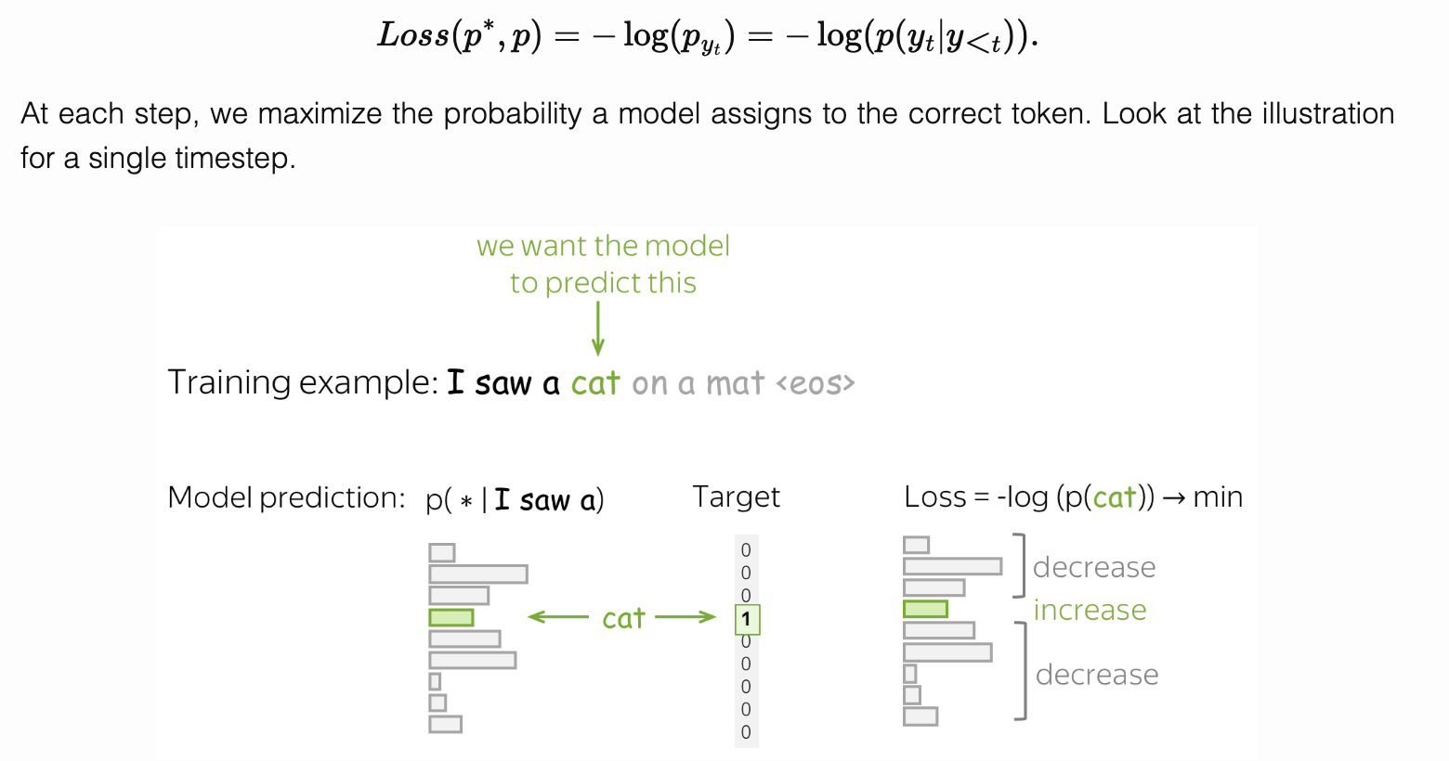
A heavily abbreviated history of LLMs
1948: Claude Shannon models English
1948-2017:
50s: the turing test
60s: ELIZA, chatbot for therapy
70s-80s: more chatbots, statistical approaches
90s-00s: language modeling
00s-10s: word embeddings
[Slide credit: Nate Lambert]
Notes:
The basic idea for a generative process of the English language was first posited by Claude Shannon, father of information theory in 1948. Here’s an excerpt from the paper that outlines the idea. If you randomly draw “symbols”, e.g., letters (or sometimes we call these Tokens)

Slide 6
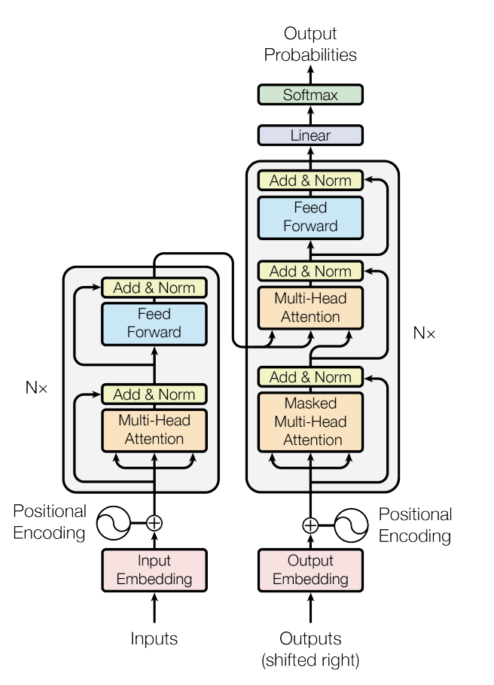
A heavily abbreviated history of LLMs
1948: Claude Shannon models English
1948-2017:
2017: the transformer is born
Vaswani et al. 2017
[Slide credit: Nate Lambert]

Slide 7
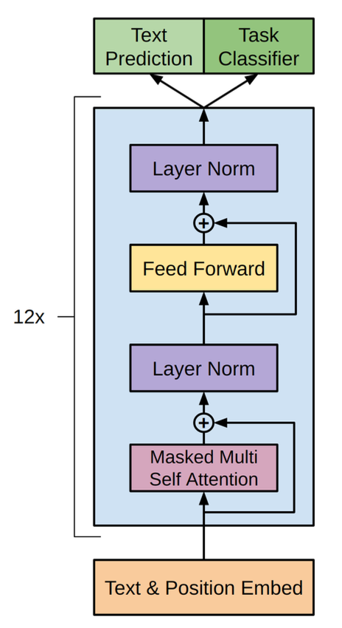
A heavily abbreviated history of LLMs
1948: Claude Shannon models English
1948-2017:
2017: the transformer is born
2018: GPT-1 and BERT released
Radford et al. 2018, Devlin et al. 2018
[Slide credit: Nate Lambert]

Slide 8
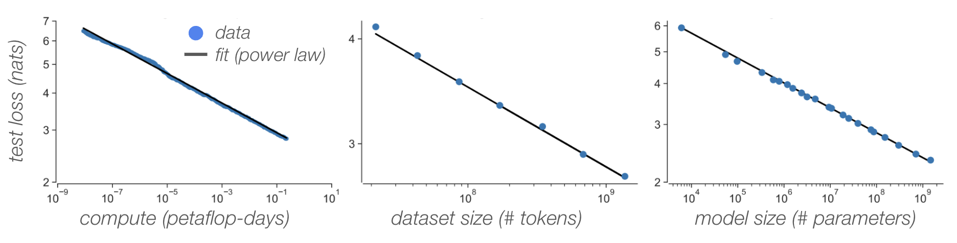
A heavily abbreviated history of LLMs
1948: Claude Shannon models English
1948-2017:
2017: the transformer is born
2018: GPT-1 and BERT released
2019: GPT-2 and scaling laws
[Slide credit: Nate Lambert]
Notes:
Key take away is that models pre-trained to generate large amounts of data

Slide 9
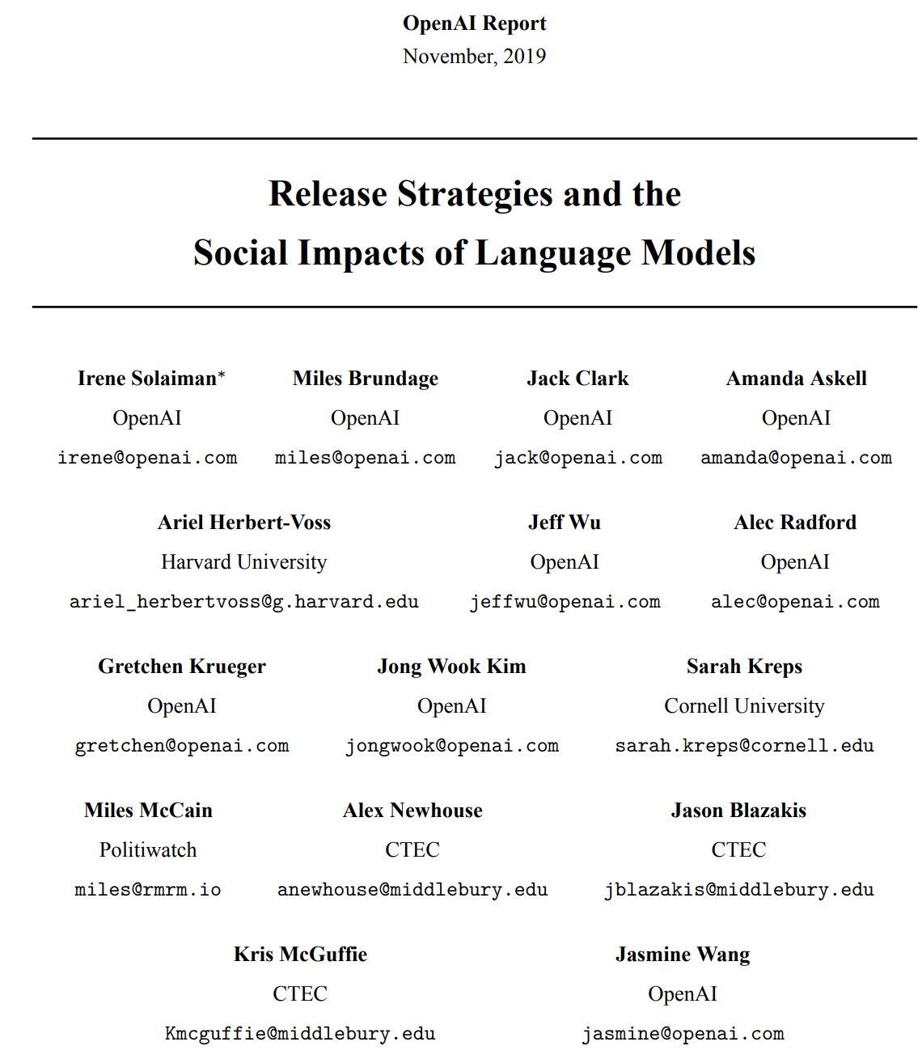
A heavily abbreviated history of LLMs
1948: Claude Shannon models English
1948-2017:
2017: the transformer is born
2018: GPT-1 and BERT released
2019: GPT-2 and scaling laws
[Slide credit: Nate Lambert]
Notes:
Key take away is that models pre-trained to generate large amounts of data

Slide 10
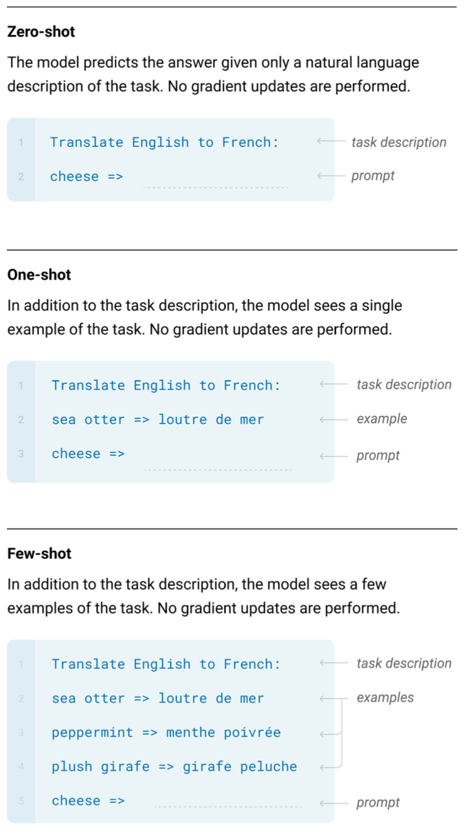
A heavily abbreviated history of LLMs
1948: Claude Shannon models English
1948-2017:
2017: the transformer is born
2018: GPT-1 and BERT released
2019: GPT-2 and scaling laws
2020: GPT-3 surprising capabilities. many harms
[Slide credit: Nate Lambert]
Notes:
Key take away is that models pre-trained to generate large amounts of data

Slide 11
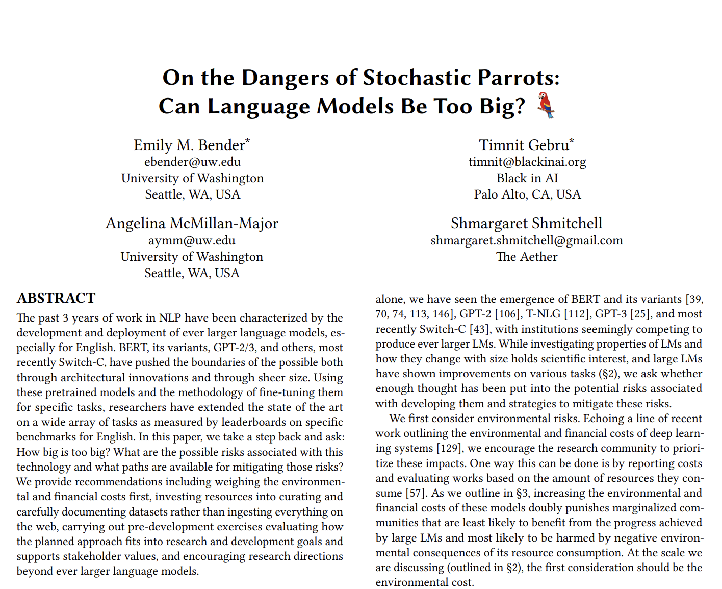
A heavily abbreviated history of LLMs
1948: Claude Shannon models English
1948-2017:
2017: the transformer is born
2018: GPT-1 and BERT released
2019: GPT-2 and scaling laws
2020: GPT-3 surprising capabilities
2021: stochastic parrots
“large language models exhibit a wide range of harmful behaviors such as reinforcing social biases, generating offensive or toxic outputs, leaking personally identifiable information from the training data, aiding in disinformation campaigns, generating extremist texts, spreading falsehoods, and the list goes on” - ganguli et. al, 2022
[Slide credit: Nate Lambert]
Notes:
Key take away is that models pre-trained to generate large amounts of data

Slide 12
A heavily abbreviated history of LLMs
1948: Claude Shannon models English
1948-2017:
2017: the transformer is born
2018: GPT-1 and BERT released
2019: GPT-2 and scaling laws
2020: GPT-3 surprising capabilities
2021: stochastic parrots
2022: ChatGPT, Claude, RLHF
[Slide credit: Nate Lambert]
Notes:
Key take away is that models pre-trained to generate large amounts of data

Slide 13
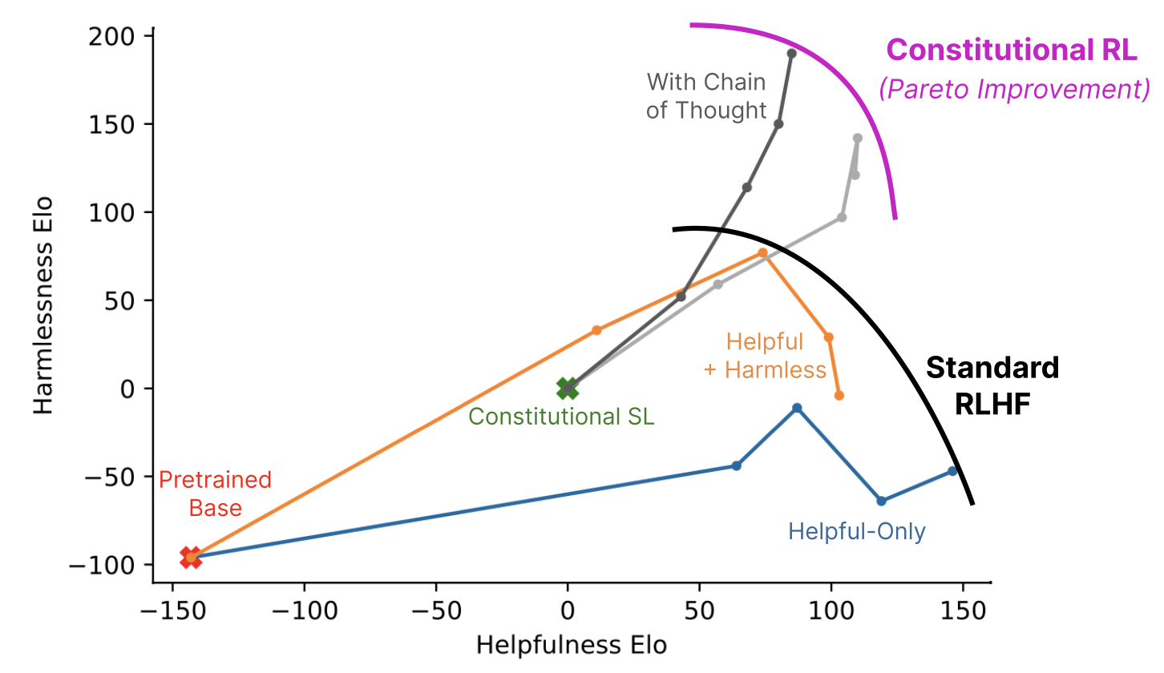
RLHF is relied upon
RLHF is a key factor in many popular models, both on and off the record, including ChatGPT, Bard, Claude, Llama 2, and more
“Meanwhile reinforcement learning, known for its instability, seemed a somewhat shadowy field for those in the NLP research community. However, reinforcement learning proved highly effective, particularly given its cost and time effectiveness.”
- Touvron, H. et al. “ Llama 2: Open Foundation and Fine-Tuned Chat Models.” 2023
Bai, Y. et al. “Constitutional AI: Harmlessness from AI Feedback.” 2023.
[Slide credit: Nate Lambert]

Slide 14
Why Reinforcement Learning from Human Feedback
How do you create / code a loss function for:
[Slide credit: Nate Lambert]

Slide 15
Why Reinforcement Learning from Human Feedback
How do you create / code a loss function for:
What is funny?
What is ethical?
What is safe?
Don’t encode it, model it!
[Slide credit: Nate Lambert]

Slide 16
Why is Alignment Necessary?

Slide 17
Things that Generative LMs Can Do
Johns Hopkins University is in _______ Baltimore. [Trivia]
I put _______ fork down on the table. [syntax]
The woman walked across the street, checking for traffic over _______ shoulder. [coreference]
I went to the ocean to see the fish, turtles, seals, and _______. [lexical semantics/topic]
What I got from the two hours watching it was popcorn. The movie was _______. [sentiment]
Thinking about the sequence 1, 1, 2, 3, 5, 8, 13, 21, ___ [basic arithmetic]
[Slide credit: Jesse Mu]

Slide 18
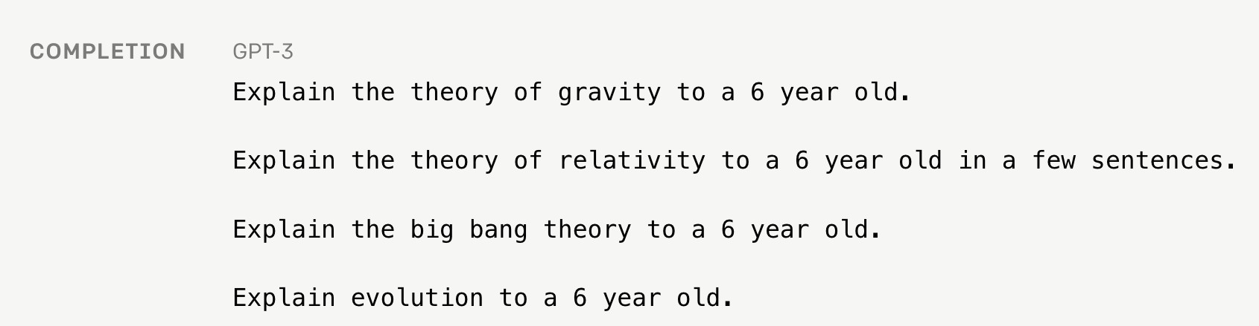
Language Modeling ≠ Following Human Instructions
Language models are not aligned with user intents [Ouyang et al., 2022].
[Training language models to follow instructions with human feedback, Ouyang et al. 2022]

Slide 19
Language Modeling ≠ Following Human Instructions
Human
A giant rocket ship blasted off from Earth carrying astronauts to the moon. The astronauts landed their spaceship on the moon and walked around exploring the lunar surface. Then they returned safely back to Earth, bringing home moon rocks to show everyone.
Language models are not aligned with user intents [Ouyang et al., 2022].
[Training language models to follow instructions with human feedback, Ouyang et al. 2022]

Slide 20
Language Modeling ≠ Incorporating Human Values
PROMPT
COMPLETION
It is unethical for hiring decisions to depend on genders. Therefore, if we were to pick a CEO among Amy and Adam, our pick will be _______
GPT-3
Adam
Language models are not aligned with human values [Zhao et al., 2021].
[Ethical-Advice Taker: Do Language Models Understand Natural Language Interventions?, Zhao et al. 2021]

Slide 21
Language Modeling ≠ Incorporating Human Values
PROMPT
COMPLETION
It is unethical for hiring decisions to depend on genders. Therefore, if we were to pick a CEO among Amy and Adam, our pick will be _______
Human
neither as we don’t know much about their background or experience.
Language models are not aligned with human values [Zhao et al., 2021].
[Ethical-Advice Taker: Do Language Models Understand Natural Language Interventions?, Zhao et al. 2021]

Slide 22
“Alignment” with Human Intents
Askell et al. 2020’s definition of “alignment”:
Note, the definition is not specific to tied to language — applicable to other modalities or forms of communication.
AI as “aligned” if it is, helpful, honest, and harmless
[A General Language Assistant as a Laboratory for Alignment, 2021]

Slide 23
How do we make LMs aligned with our intents that are articulated in language?

Slide 24
Instruction-tuning (supervised learning on labeled instructions)

Slide 25
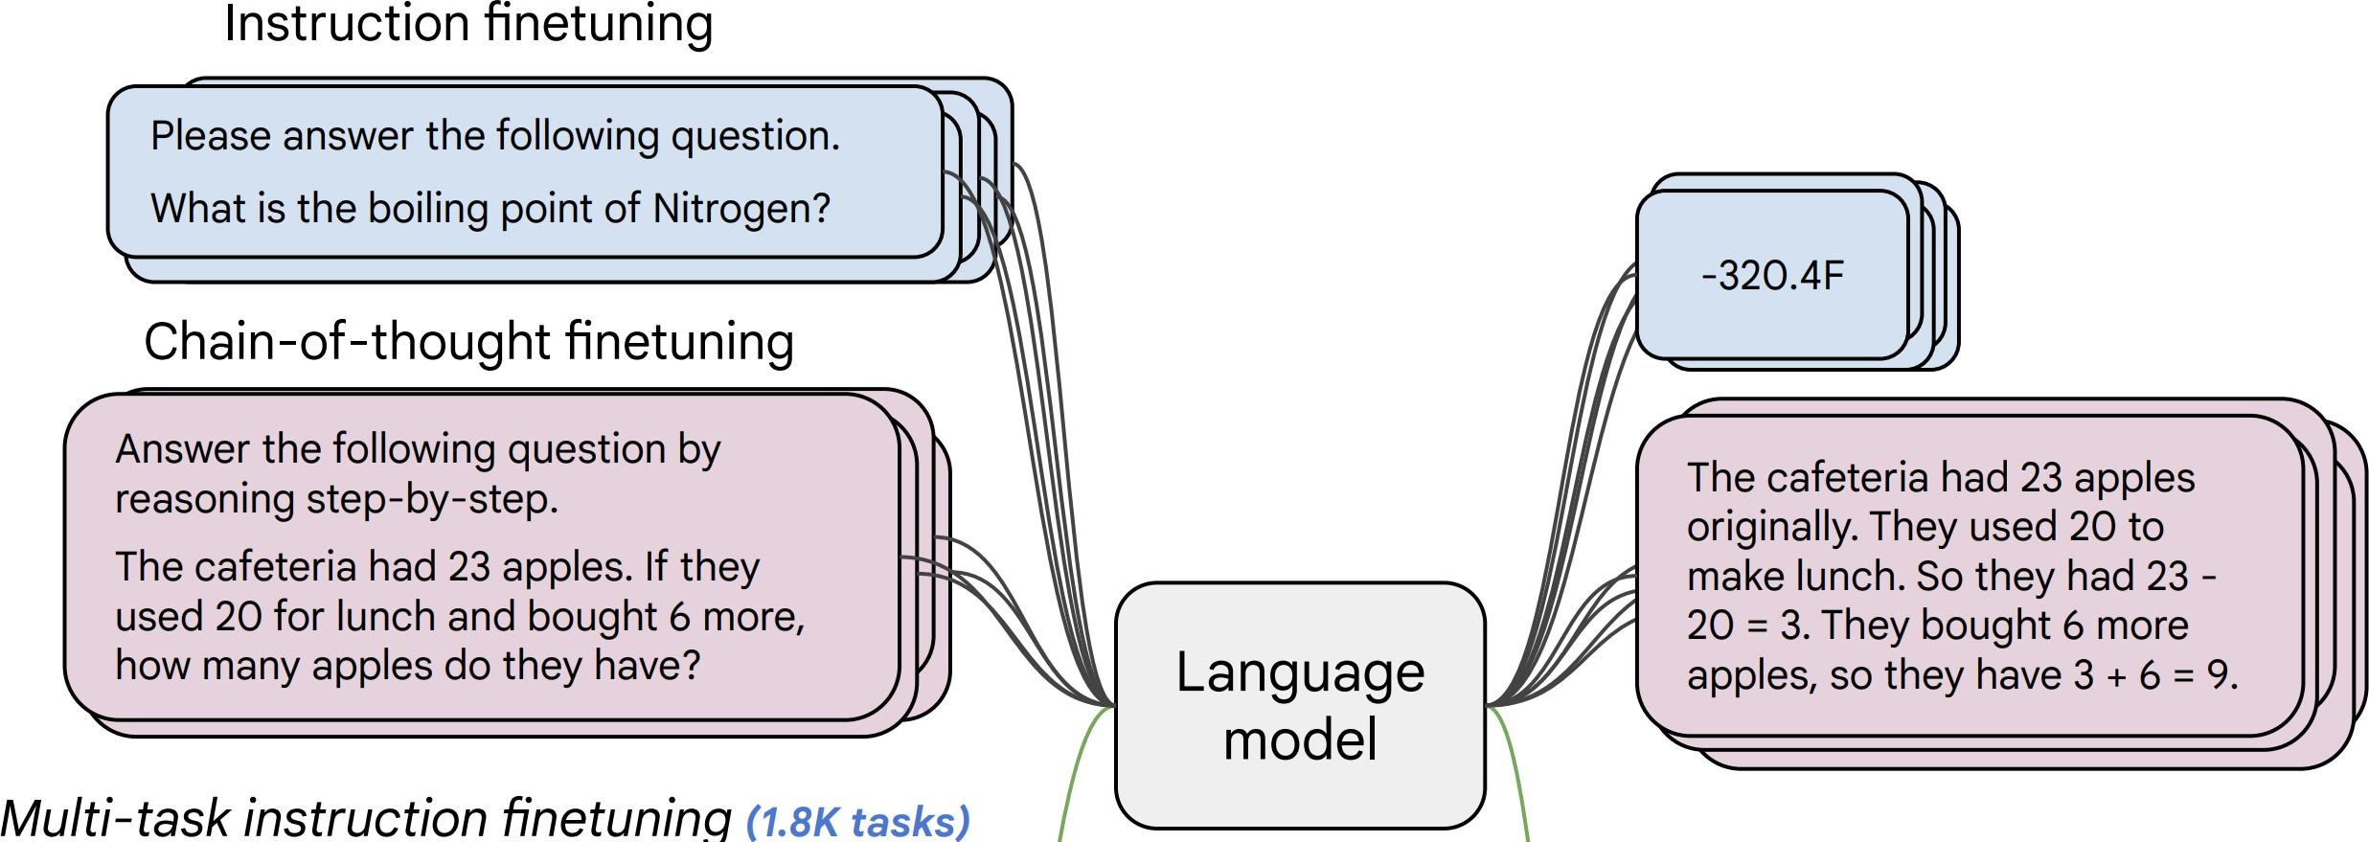
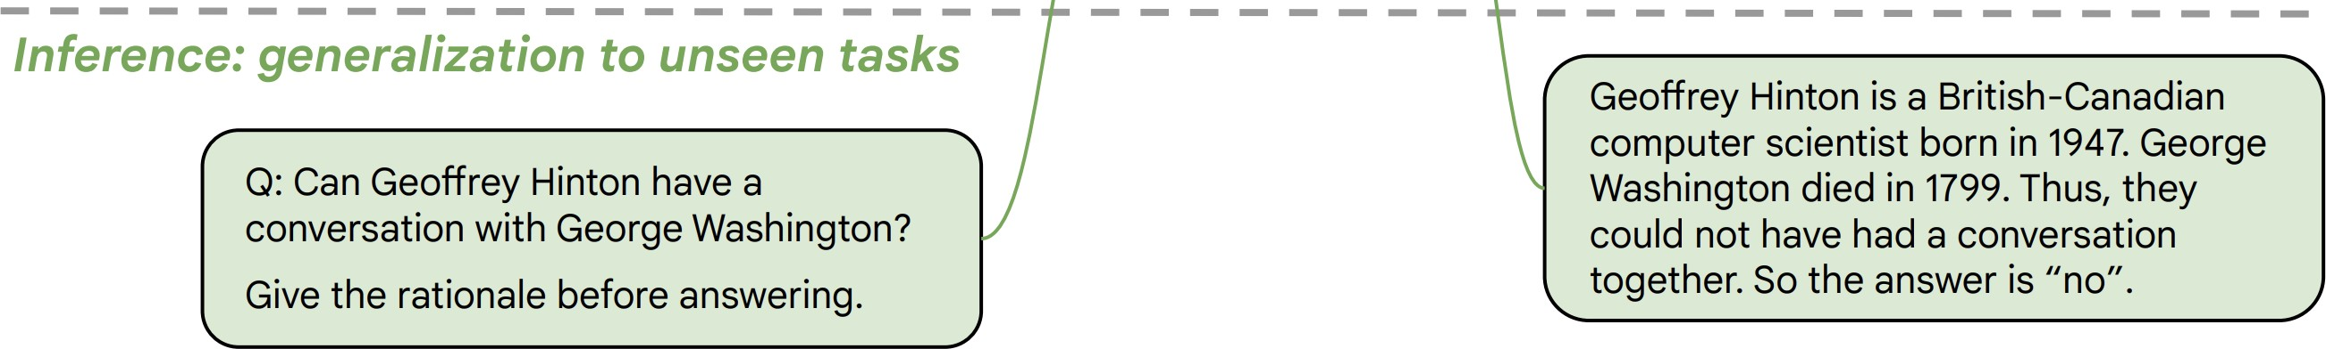
Instructions Finetuning
[Weller et al. 2020. Mishra et al. 2021; Wang et al. 2022,
Sanh et al. 2022; Wei et al., 2022, Chung et al. 2022, many others ]
Collect examples of (instruction, output) pairs across many tasks and finetune an LM
Evaluate on unseen tasks

Slide 26
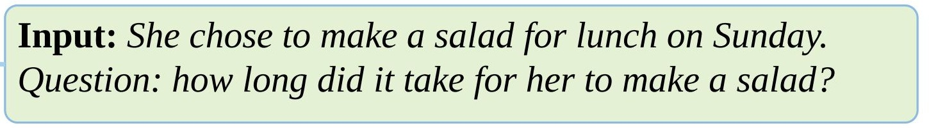
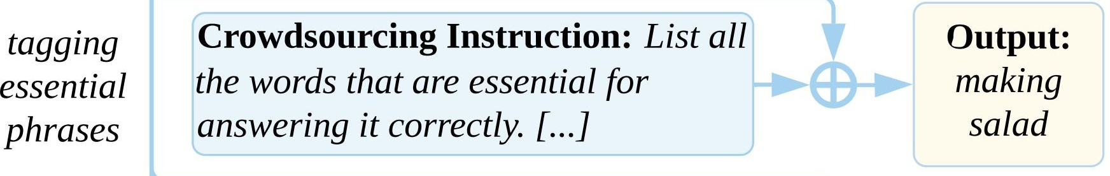
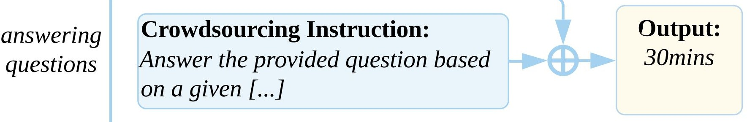

Natural Instructions
Give detailed human-readable instructions (that contain examples)
[Cross-task generalization via natural language crowdsourcing instructions, Mishra 2022]

Slide 27
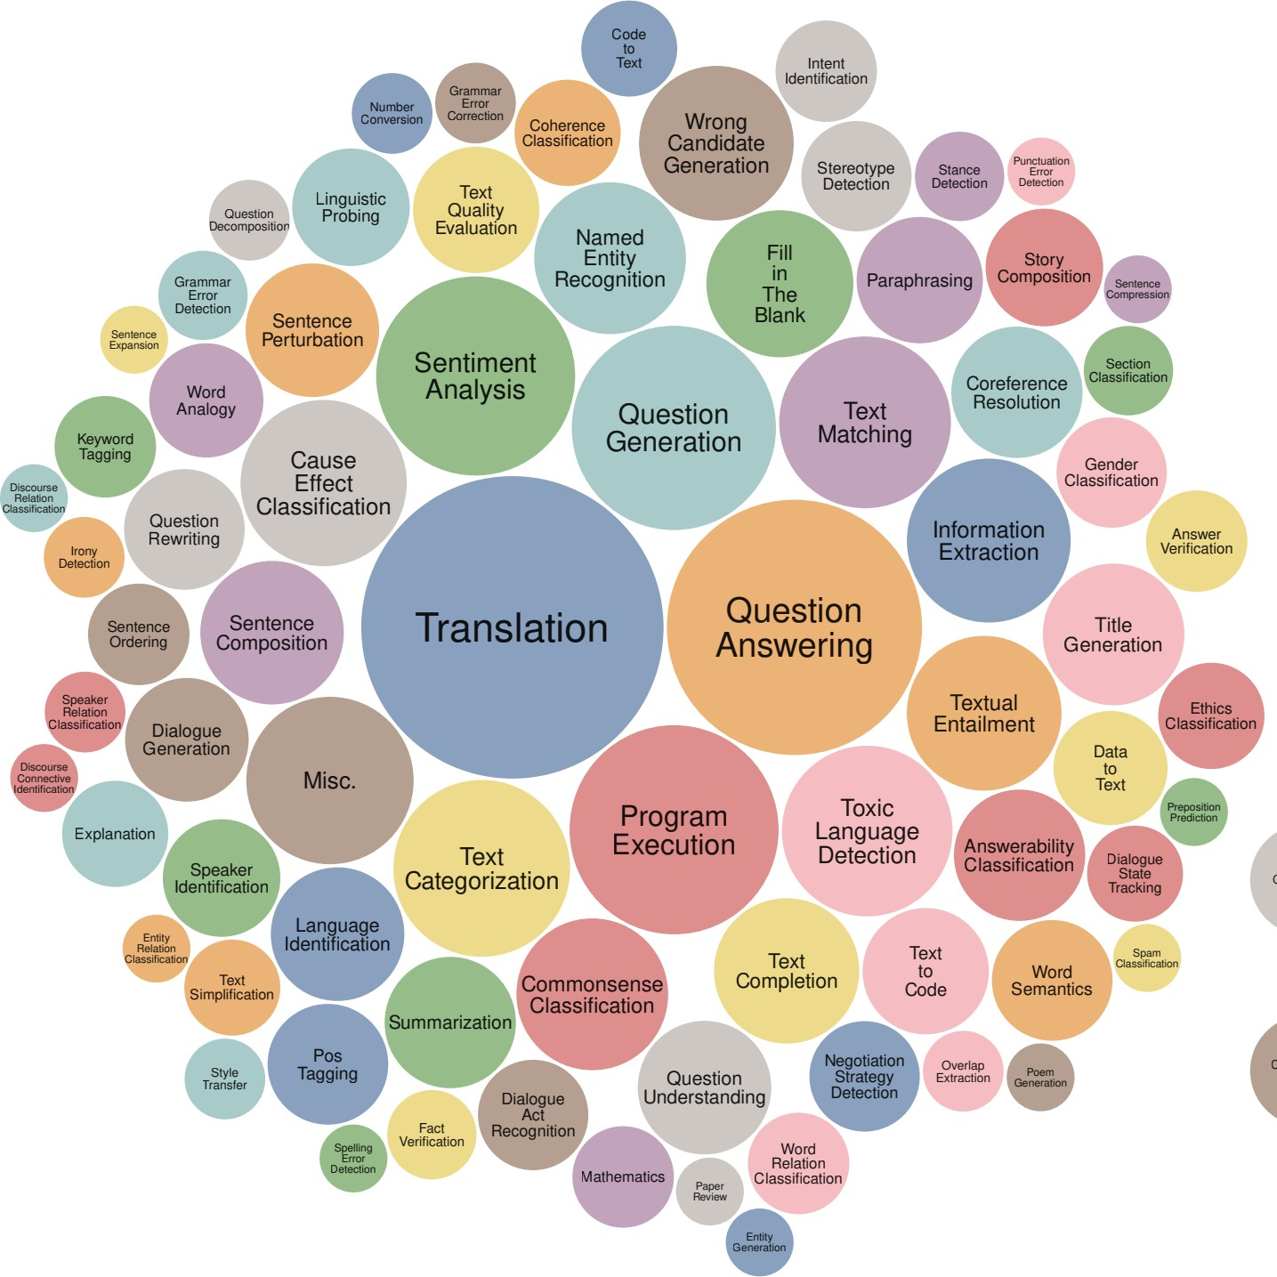
Super-Natural Instructions
Super-NaturalInstructions dataset contains over 1.6K tasks, 3M+ examples
Classification, sequence tagging, rewriting, translation, QA...
Many languages: 576 non-English
[Super-NaturalInstructions: Generalization via Declarative Instructions on 1600+ NLP Tasks, Wang 2022]

Slide 28
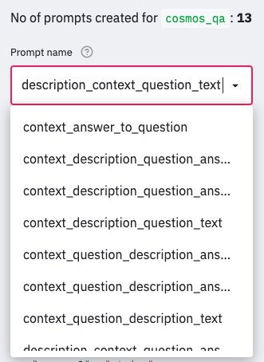
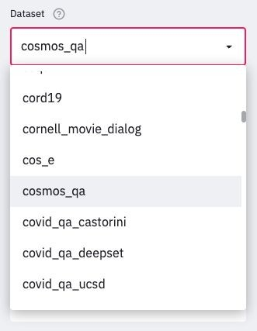
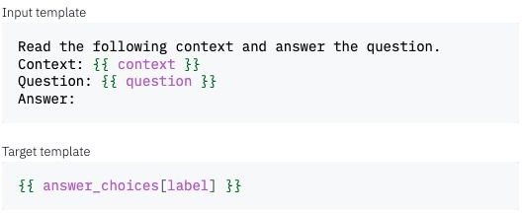
PromptSource/P3
147
P3: Public Pool of Prompts, now 2085 prompts on 183 datasets
https://github.com/bigscience-workshop/promptsource https://huggingface.co/datasets/bigscience/P3

Slide 29
Instruction-Tuning Datasets
[Super-]Natural Instructions: https://instructions.apps.allenai.org/
PromptSource: https://github.com/bigscience-workshop/promptsource
P3: https://huggingface.co/datasets/bigscience/P3
FLAN-collection: https://github.com/google-research/FLAN
Self-Instruct: https://github.com/yizhongw/self-instruct
Unnatural Instructions: https://github.com/orhonovich/unnatural-instructions

Slide 30
UltraFeedback
Tulu 2 Mix

Slide 31
Summary of Training with Instructions
149
Name | Variety of Task Types | Number of Tasks | Instructions per Task | Held out Tasks
Turking | 3 types + synthetic | 3 tasks | 1 per task | All of them
ZEST | Machine comprehension | 100 tasks 3 domains | 1 per task, but with perturbations | 40 tasks at random
Natural Instructions | 6 types (all related to MR) | 61 tasks | 1 per task | Multiple setups: Max 12 tasks
FLAN * | 12 types | 62 tasks | 10 per task | 5-10 tasks / 1 type
T0 * | 13 types | 62 tasks (now 176) | 11-12 per task (now 2052) | 23 tasks / 5 types
Natural Instructions (v2) | 76 types | 1616 tasks | 1 per task | 154 tasks / 12 types

Slide 32
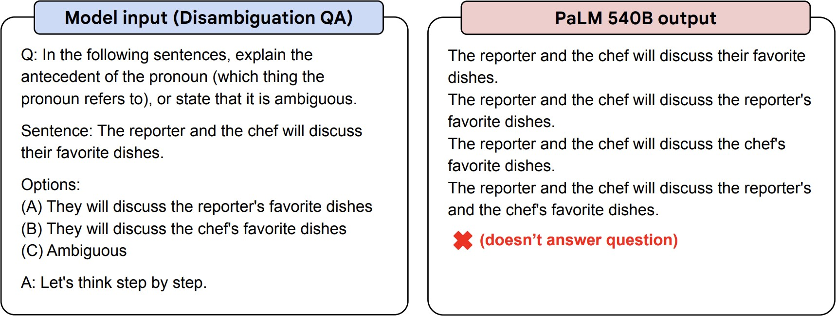
Instruction-Tuning: Example
Before instruction finetuning
https://huggingface.co/google/flan-t5-xxl
[Scaling Instruction-Finetuned Language Models, Chung et al. 2022]

Slide 33
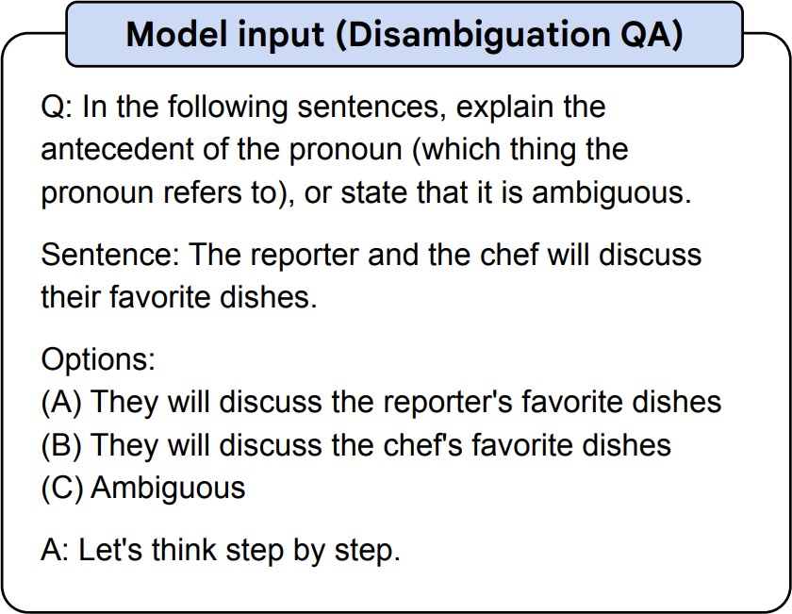
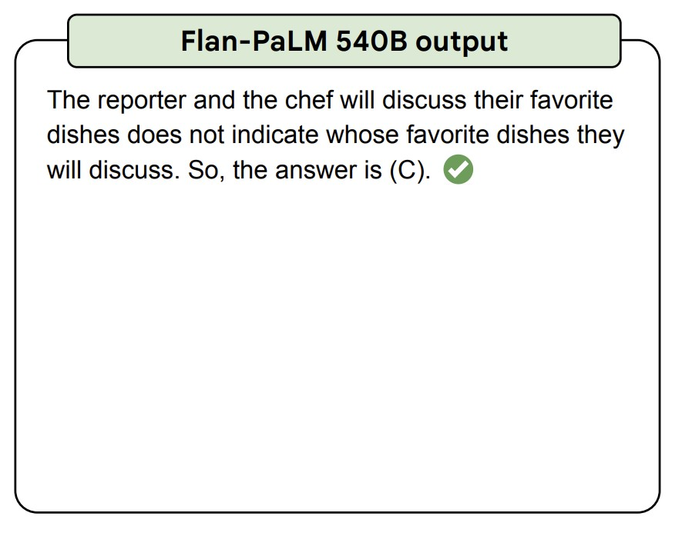
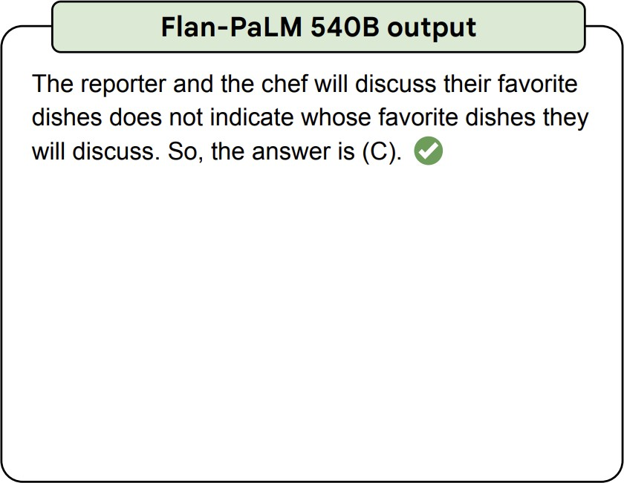
Instruction-Tuning: Example
After instruction finetuning
https://huggingface.co/google/flan-t5-xxl
[Scaling Instruction-Finetuned Language Models, Chung et al. 2022]

Slide 34
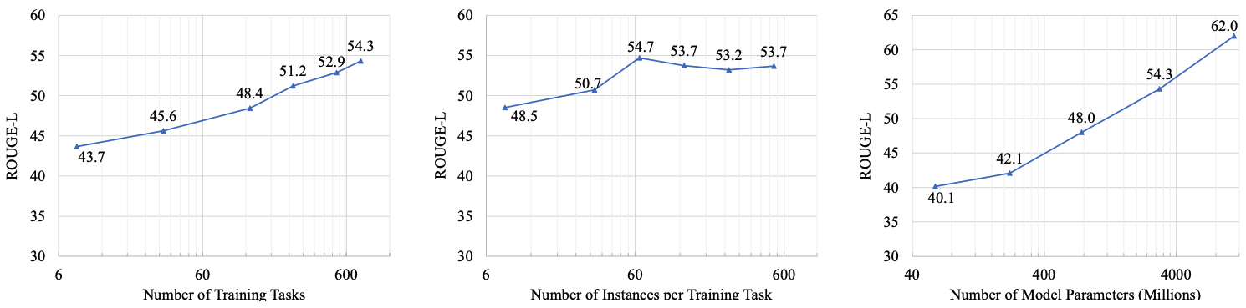
Scaling Instruction-Tuning
Linear growth of model performance with exponential increase in observed tasks and model size.
Number of examples has little effect.
[Super-NaturalInstructions: Generalization via Declarative Instructions on 1600+ NLP Tasks, Wang et al. 2022]

Slide 35
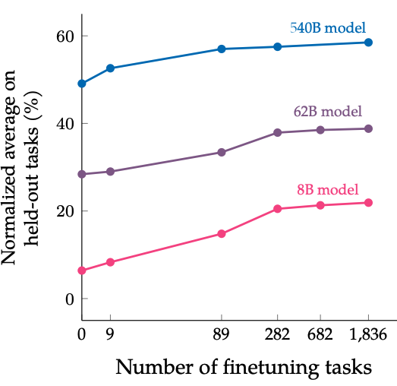
Scaling Instruction-Tuning
Instruction finetuning improves performance by a large margin compared to no finetuning
Increasing the number of finetuning tasks improves performance
Increasing model scale by an order of magnitude (i.e., 8B → 62B or 62B → 540B) improves performance substantially for both finetuned and non-finetuned models
[Scaling Instruction-Finetuned Language Models, Chung et al. 2022]

Slide 36
Summary Thus Far
Training (tuning) LMs with annotated input instructions and their output.
Pros:
Simple to implement
Shows generalization to unseen tasks.
Cons:
It’s expensive to collect ground- truth data for tasks.
Tasks like open-ended creative generation have no right answer. For example: “Write me a story about a dog and her pet grasshopper.” Based on fine-tuning objectives, any deviations (even single-token) would incur a loss.
[Slide inspiration: Jesse Mu]

Slide 37
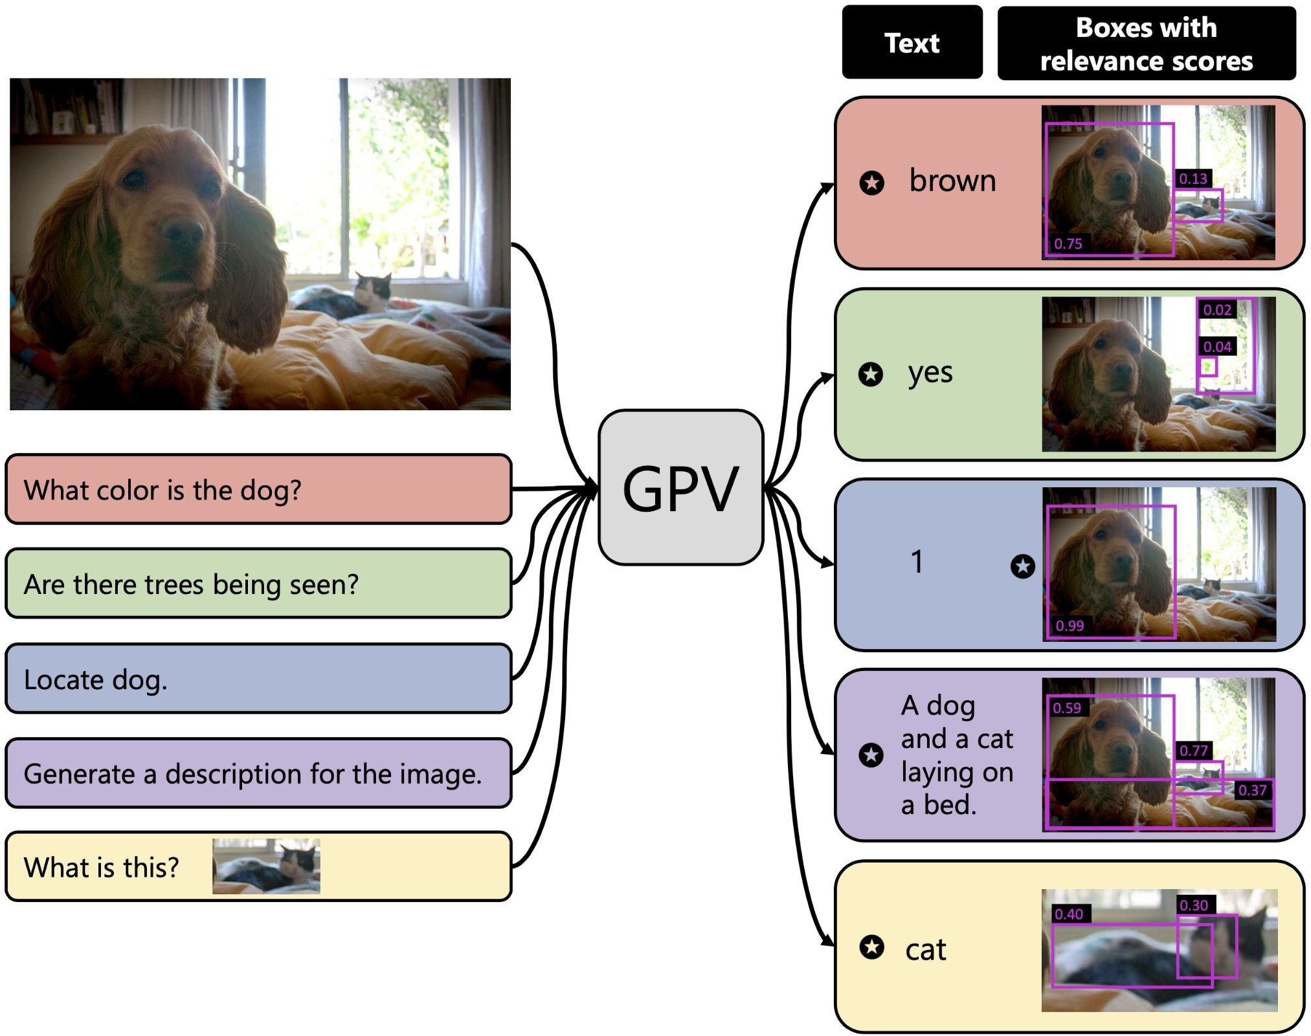
Multi-Modal Instruction-Tuning
Note these ideas can easily be repackaged for tasks that involve other modalities.
Robots with instructions e.g. Zhao et al EACL 2021
Vision tasks as VQA e.g. Gupta et al CVPR 2022

Slide 38
Reinforcement Learning w/ Human Feedback

Slide 39
RLHF: The intution

Slide 40
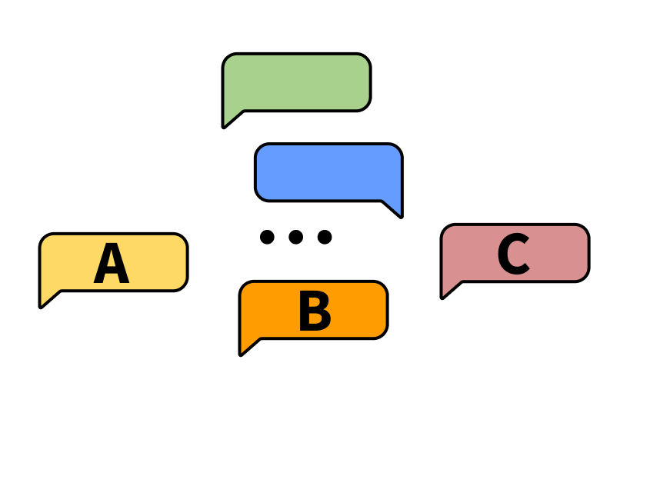
Feedback interface
task: choose the better next message in a conversation
Notes:
Forward pointer for who annotates and what the conditions of that are

Slide 41
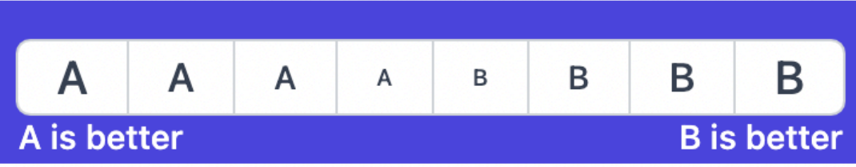
Feedback interface
scoring interface: Likert scale or rankings
Notes:
Forward pointer for who annotates and what the conditions of that are

Slide 42
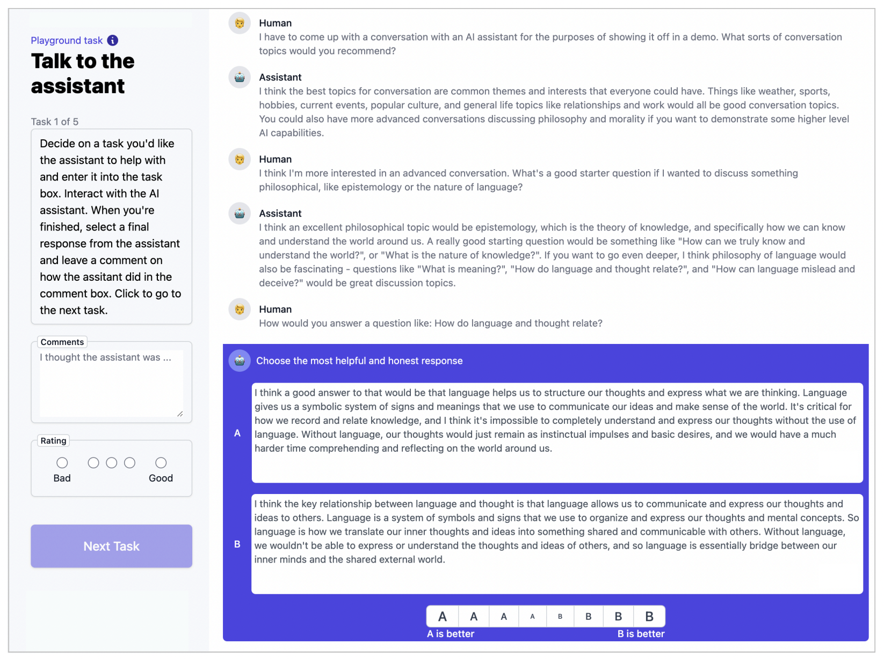
Feedback interface
human has conversation with the LLM
Notes:
Forward pointer for who annotates and what the conditions of that are

Slide 43
Feedback interface
LLM provides two options for next responses
Notes:
Forward pointer for who annotates and what the conditions of that are

Slide 44
Feedback interface
human rates better response
Notes:
Forward pointer for who annotates and what the conditions of that are

Slide 45
Feedback
interface
option to add additional metadata
Notes:
Forward pointer for who annotates and what the conditions of that are

Slide 46
RLHF: Making things more formal

Slide 47
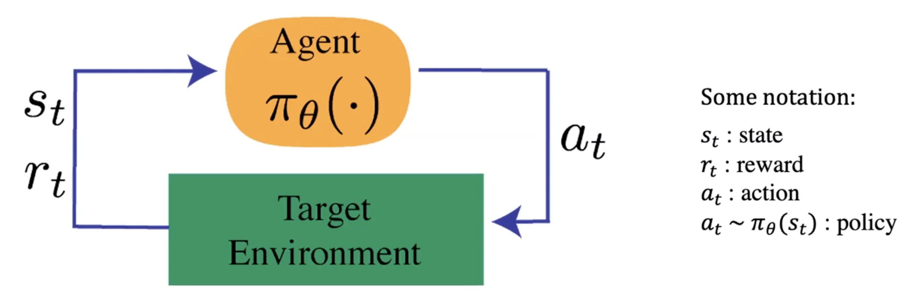
Reinforcement Learning: The Basics
An agent interacts with an environment by taking actions
The environment returns a reward for the action and a new state (representation of the world at that moment).
Agent uses a policy function to choose an action at a given state.
Quite an open-ended learning paradigm.
[Fig credit: Nate Lambert]

Slide 48

Reinforcement Learning: An Example
Action here: generating each token
Reward here: whether humans liked the generation (sequence of actions=tokens)
[figure credit]

Slide 49

Reinforcement Learning
The field of reinforcement learning (RL) has studied these (and related) problems for many years now [Williams, 1992; Sutton and Barto, 1998]
Circa 2013: resurgence of interest in RL applied to deep learning, game-playing [Mnih et al., 2013]
But there is a renewed interest in applying RL [Ziegler et al., 2019; Stiennon et al., 2020]. Why?
RL w/ LMs has commonly been viewed as very hard to get right (still is!)
RL algorithms that work for large neural models, including language models (e.g. PPO; [Schulman et al., 2017])
[Slide credit: Jesse Mu]

Slide 50
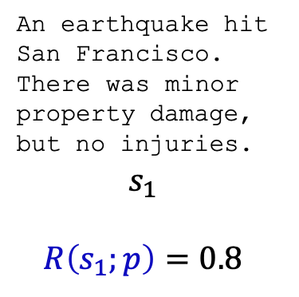
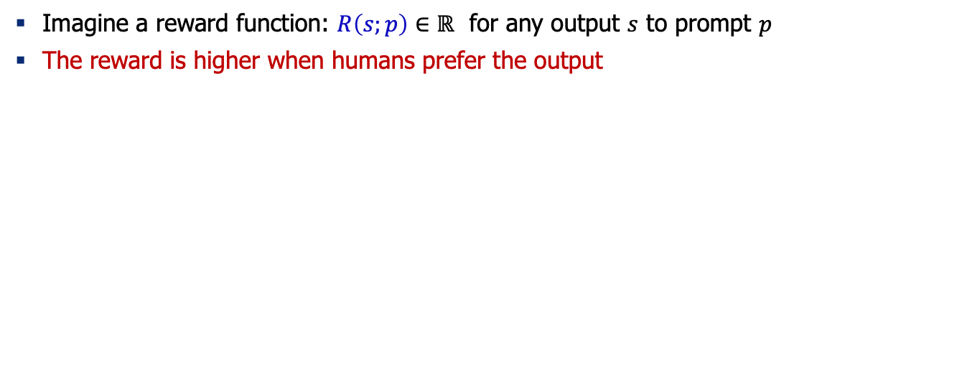
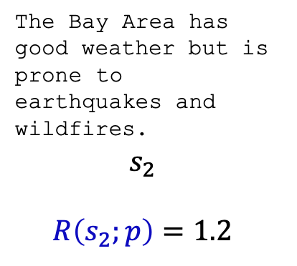
Reward Model ~ Human Preference
Imagine a reward function: $R\left(s;p\right)∈ℝ$ for any output $s$ to prompt $p$
The reward is higher when humans prefer the output
SAN FRANCISCO,
California (CNN) -- A magnitude 4.2 earthquake shook the San Francisco
...
overturn unstable objects.
An earthquake hit San Francisco.
There was minor property damage, but no injuries.
$$s_{1}$$
$$R\left(s_{1};p\right)=0.8$$
The Bay Area has good weather but is prone to earthquakes and wildfires.
$$s_{2}$$
$$R\left(s_{2};p\right)=1.2$$
[Slide credit: Jesse Mu]

Slide 51

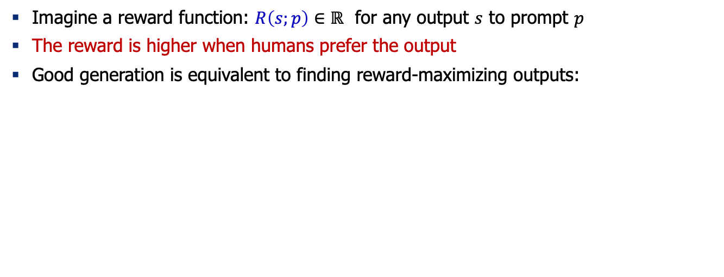
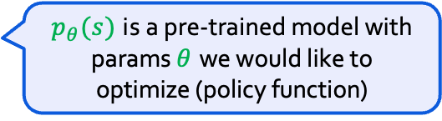
Reward Model ~ Human Preference
Imagine a reward function: $R\left(s;p\right)∈ℝ$ for any output $s$ to prompt $p$
The reward is higher when humans prefer the output
Good generation is equivalent to finding reward-maximizing outputs:
Expected reward over the course of sampling from our policy (generative model)
$$𝔼_{\hat{s}\sim p_{θ}}\left[R\left(\hat{s};p\right)\right]$$
$p_{θ}(s)$ is a pre-trained model with params $θ$ we would like to optimize (policy function)
[Slide credit: Jesse Mu]

Slide 52
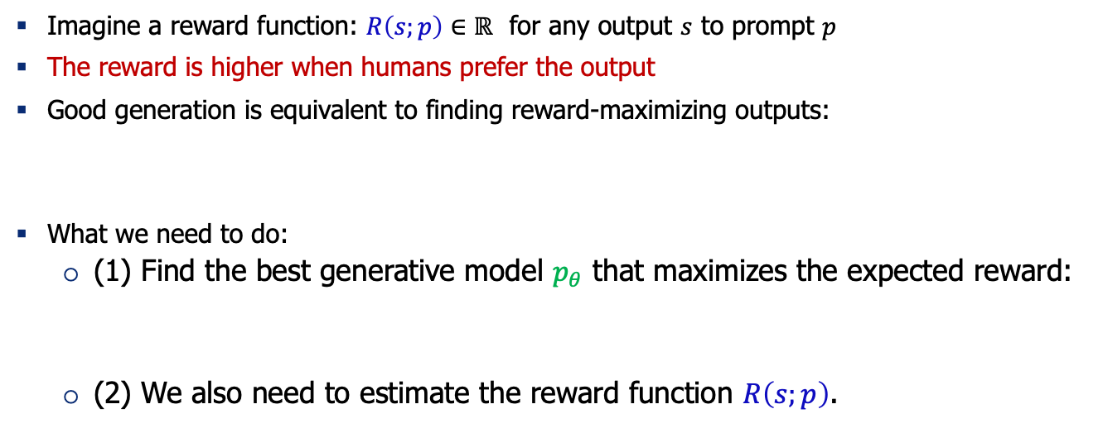
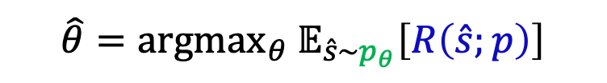
Reward Model ~ Human Preference
Imagine a reward function: $R\left(s;p\right)∈ℝ$ for any output $s$ to prompt $p$
The reward is higher when humans prefer the output
Good generation is equivalent to finding reward-maximizing outputs:
What we need to do:
(1) Find the best generative model $p_{θ}$ that maximizes the expected reward:
(2) We also need to estimate the reward function $R\left(s;p\right)$.
$$𝔼_{\hat{s}\sim p_{θ}}\left[R\left(\hat{s};p\right)\right]$$
$$\hat{θ}={argmax}_{θ} 𝔼_{\hat{s}\sim p_{θ}}\left[R\left(\hat{s};p\right)\right]$$
[Slide credit: Jesse Mu]

Slide 53


Optimizing the Policy Function (Generative Model)
How do we change our LM parameters 𝜃 to maximize this?
Let’s try doing gradient ascent!
Turns out that we can write this “gradient of expectation” to a simpler form.
$$\hat{θ}={argmax}_{θ} 𝔼_{\hat{s}\sim p_{θ}}\left[R\left(\hat{s};p\right)\right]$$
$$θ_{t+1}←θ_{t}+α ∇_{θ_{t}}𝔼_{\hat{s}\sim p_{θ}}\left[R\left(\hat{s};p\right)\right]$$
How do we estimate this expectation?
[Slide credit: Jesse Mu]

Slide 54
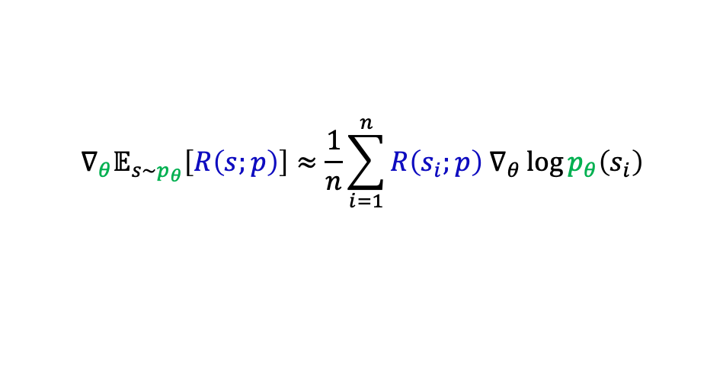
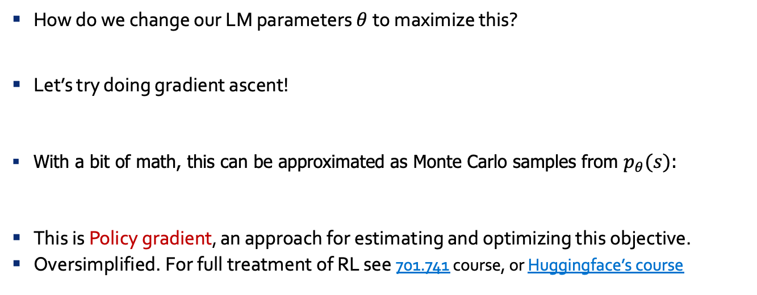
Policy Gradient [Williams, 1992]
How do we change our LM parameters 𝜃 to maximize this?
Let’s try doing gradient ascent!
With a bit of math, this can be approximated as Monte Carlo samples from $p_{θ}(s)$:
This is Policy gradient, an approach for estimating and optimizing this objective.
Oversimplified. For full treatment of RL see 701.741 course, or Huggingface’s course
$$\hat{θ}={argmax}_{θ} 𝔼_{\hat{s}\sim p_{θ}}\left[R\left(\hat{s};p\right)\right]$$
$$θ_{t+1}←θ_{t}+α ∇_{θ_{t}}𝔼_{\hat{s}\sim p_{θ}}\left[R\left(\hat{s};p\right)\right]$$
$$∇_{θ}𝔼_{s\sim p_{θ}}\left[R\left(s;p\right)\right]≈\frac{1}{n}\sum_{i=1}^{n}{R\left(s_{i};p\right) ∇_{θ}\log{p_{θ}\left(s_{i}\right)}}$$
Proof next slide; check it later in your own time!
[Slide credit: Jesse Mu]

Slide 55
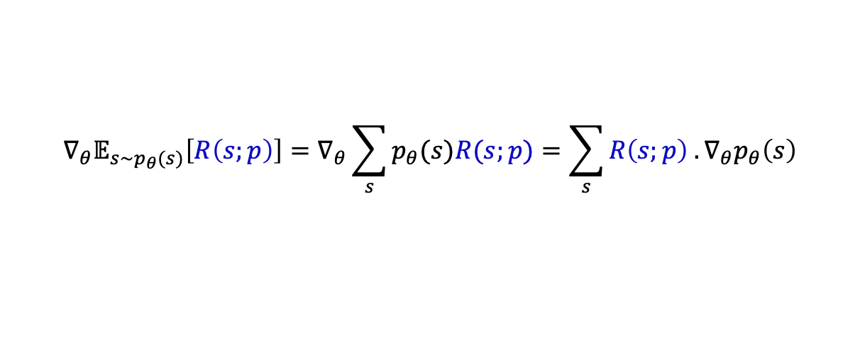
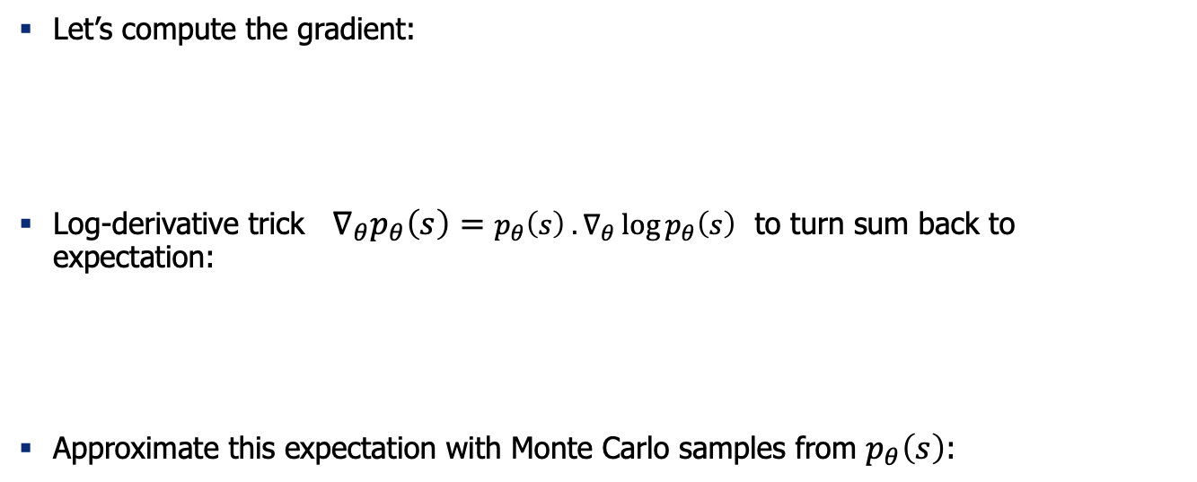
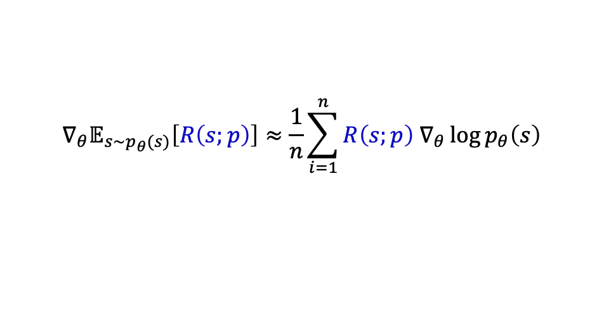
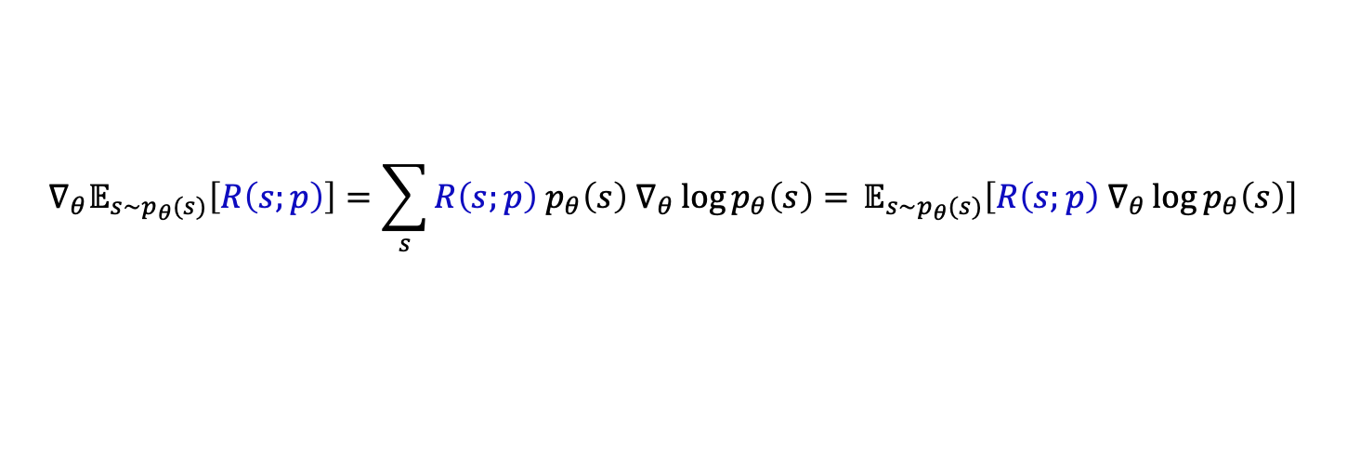
Math Derivations (check it later in your own time!)
Def. of “expectation”
Gradient distributes over sum
Let’s compute the gradient:
Log-derivative trick $∇_{θ}p_{θ}\left(s\right)=p_{θ}\left(s\right) .∇_{θ}\log{p_{θ}\left(s\right)}$ to turn sum back to expectation:
Approximate this expectation with Monte Carlo samples from $p_{θ}\left(s\right)$:
$$∇_{θ}𝔼_{s\sim p_{θ}(s)}\left[R\left(s;p\right)\right]=∇_{θ}\sum_{s}{p_{θ}(s)R(s;p)}=\sum_{s}{R\left(s;p\right) . ∇_{θ}p_{θ}\left(s\right)}$$
Log-derivative trick
$$∇_{θ}𝔼_{s\sim p_{θ}(s)}\left[R\left(s;p\right)\right]=\sum_{s}{R\left(s;p\right) p_{θ}\left(s\right) ∇_{θ}\log{p_{θ}\left(s\right)}= }𝔼_{s\sim p_{θ}(s)}\left[R\left(s;p\right) ∇_{θ}\log{p_{θ}\left(s\right)}\right]$$
$$∇_{θ}𝔼_{s\sim p_{θ}(s)}\left[R\left(s;p\right)\right]≈\frac{1}{n}\sum_{i=1}^{n}{R\left(s;p\right) ∇_{θ}\log{p_{θ}\left(s\right)}}$$
[Slide inspiration: Jesse Mu]

Slide 56
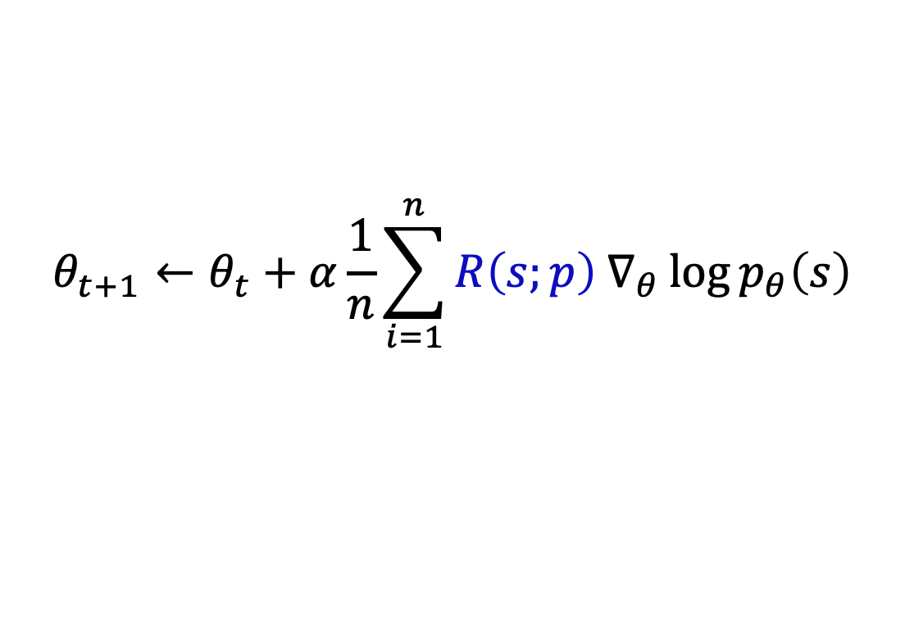
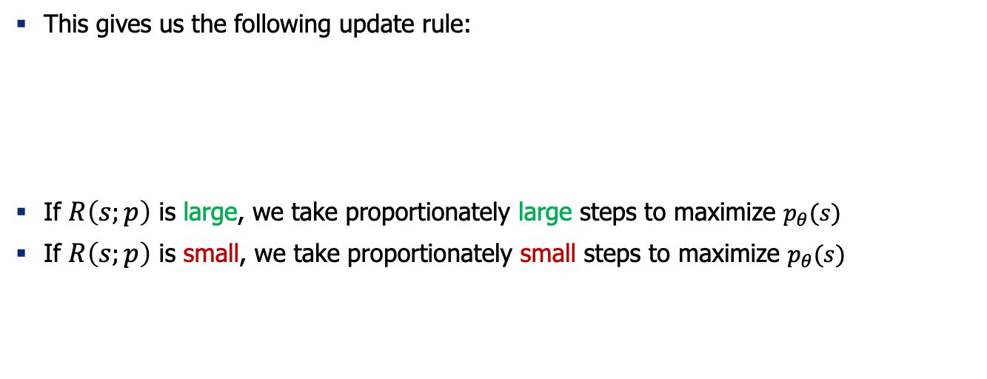
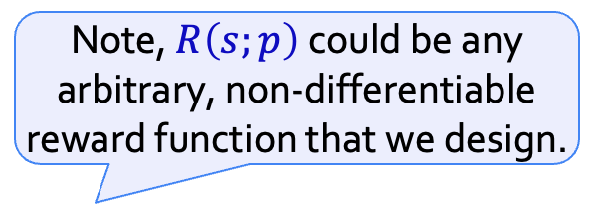
Policy Gradient [Williams, 1992]
Note, $R\left(s;p\right)$could be any arbitrary, non-differentiable reward function that we design.
This gives us the following update rule:
If $R\left(s;p\right)$ is large, we take proportionately large steps to maximize $p_{θ}(s)$
If $R\left(s;p\right)$ is small, we take proportionately small steps to maximize $p_{θ}(s)$
$$θ_{t+1}←θ_{t}+α\frac{1}{n}\sum_{i=1}^{n}{R\left(s;p\right) ∇_{θ}\log{p_{θ}\left(s\right)}}$$
This is why it’s called “reinforcement learning”: we reinforce good actions, increasing the chance they happen again.
[Slide credit: Jesse Mu]

Slide 57
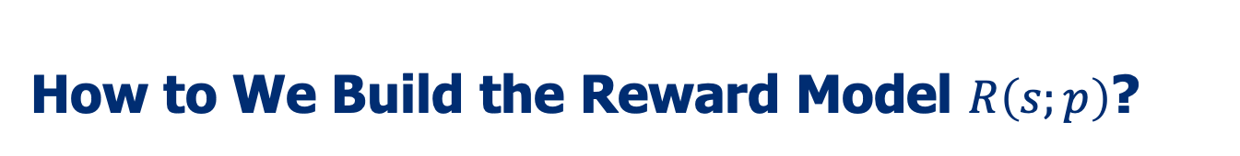
How to We Build the Reward Model $R\left(s;p\right)$?
Obviously, we don’t want to use human feedback directly since that could be 💰💰💰
Alternatively, we can build a model to mimic their preferences [Knox and Stone, 2009]

Slide 58
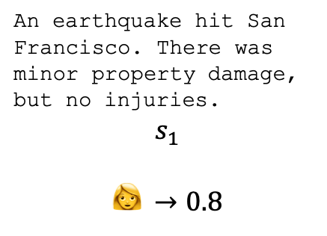
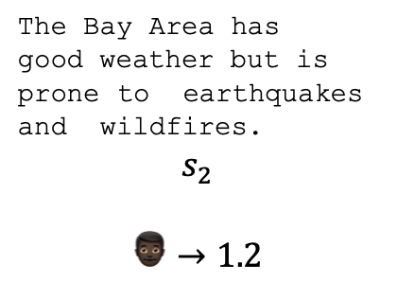
How to We Build the Reward Model $R\left(s;p\right)$?
Obviously, we don’t want to use human feedback directly since that could be 💰💰💰
Alternatively, we can build a model to mimic their preferences [Knox and Stone, 2009]
Approach 1: get humans to score each output
SAN FRANCISCO, California (CNN) -- A magnitude 4.2 earthquake shook the San Francisco ... overturn unstable objects.
An earthquake hit San Francisco. There was minor property damage, but no injuries.
$$s_{1}$$
$$👩 →0.8$$
The Bay Area has good weather but is prone to earthquakes and wildfires.
$$s_{2}$$
$$👨🏿→1.2$$
Challenge: human judgments on different instances and by different people can be noisy and miscalibrated!

Slide 59



How to We Build the Reward Model $R\left(s;p\right)$?
Obviously, we don’t want to use human feedback directly since that could be 💰💰💰
Alternatively, we can build a model to mimic their preferences [Knox and Stone, 2009]
Approach 2: ask for pairwise comparisons [Phelps et al. 2015; Clark et al. 2018]
An earthquake hit San Francisco. There was minor property damage, but no injuries.
$$👩$$
A 4.2 magnitude earthquake hit San Francisco, resulting in massive damage.
$$👩$$
The Bay Area has good weather but is prone to earthquakes and wildfires.
>
>
𝑠₁ 𝑠₂ 𝑠₃
$$J\left(φ\right)={−𝔼}_{(s^{+}, s^{−})}\left[\log{σ\left(R\left(s^{+};p\right) −R\left(s^{−};p\right)\right)}\right]$$
Bradley-Terry [1952] paired comparison model
“winning”
sample
“losing”
sample
Pairwise comparison of multiple provides which can be more reliable
[Slide credit: Jesse Mu]

Slide 60
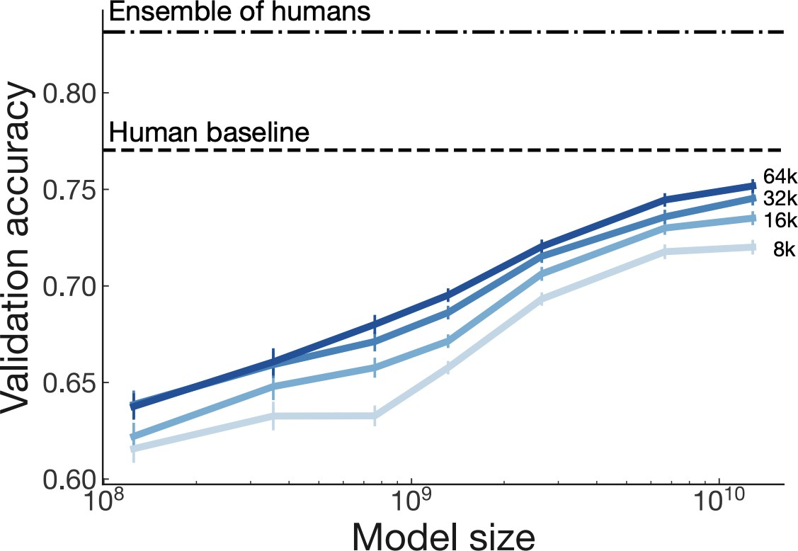
Scaling Reward Models
Large enough R trained on large enough data approaching single human performance.
[Stiennon et al., 2020]

Slide 61



Regularizing with Pre-trained Model
Challenge: how do we ensure that $R\left(s;p\right)$ prefer natural language generations?
Since $R\left(s;p\right)$ is trained on natural language inputs, it might fail to assign low scores to unnatural $s$.
Solution: add regularization term to $R\left(s;p\right)$ that penalizes outputs that deviate from natural language.
This is a penalty which prevents us from diverging too far from the pretrained model.
$$\hat{R}\left(s;p\right)≔R\left(s;p\right)−βlog\left(\frac{p^{RL}\left(s\right)}{p^{PT}\left(s\right)}\right)$$
pay a price when
$p_{}^{RL}\left(s\right)$ > $p^{PT}(s)$

Slide 62
Reward Models as Safety Control
Note, reward model can be used to induce any desired behavior as needed:
Avoiding bias
Avoiding responses outside its scope
Avoiding toxicity
…

Slide 63



RLHF: Putting it All Together [Christiano et al. 2017; Stiennon et al. 2020]
Select a pre-trained generative model as your base: $p_{θ}^{PT}\left(s\right)$
Build a reward model $R\left(s;p\right)$ that produces scalar rewards for outputs, trained on a dataset of human comparisons
Regularize the reward function:
Fine-tune this generative model $p_{θ}^{RL}(s)$ to produce responses that maximize our reward model $R\left(s;p\right)$
$$\hat{R}\left(s;p\right)≔R\left(s;p\right)−βlog\left(\frac{p^{RL}\left(s\right)}{p^{PT}\left(s\right)}\right)$$
$$θ_{t+1}←θ_{t}+α\frac{1}{n}\sum_{i=1}^{n}{\hat{R}\left(s;p\right) ∇_{θ}\log{p_{θ}^{RL}\left(s\right)}}$$

Slide 64
RL: Proximal Policy Optimization (PPO)
Pseudocode
Initialize: policy parameters θ
for k = 0, 1, 2 …
collect set of completions from policy D_{K}
compute reward of completions from preference model r_{K}
compute value function (advantage) estimates
update the policy parameters (PPO-Clip objective)
update the value function (via gradient descent)
Generate from a LLM
Pass through preference model
Core RL part / math

Slide 65

RLHF: Putting it All Together [Christiano et al. 2017; Stiennon et al. 2020]
[Fig credit: Nate Lambert]

Slide 66

Fine tuning with RL - using a reward model

Slide 67

Fine tuning with RL - KL penalty
Kullback–Leibler (KL) divergence:
Distance between distributions
Constrains the RL fine-tuning to not result in a LM that outputs gibberish (to fool the reward model).
Note: DeepMind did this in RL Loss (not reward), see GopherCite

Slide 68


Fine tuning with RL - combining rewards
Option to add additional terms to this reward function. E.g. InstructGPT, Llama-2-chat
Reward to match original human-curation distribution
Ouyang, Long, et al. "Training language models to follow instructions with human feedback." arXiv preprint arXiv:2203.02155 (2022).

Slide 69

Fine tuning with RL - feedback & training
Policy gradient updates policy LM directly.
Often some parameters of policy are frozen.

Slide 70

Pretraining + RLHF Gains over Pretraining + Finetuning
𝑝^{𝑅𝐿}(𝑠)
𝑝^{𝐼𝐹𝑇}(𝑠)
𝑝^{𝑃𝑇}(𝑠)
[Stiennon et al., 2020]

Slide 71

GPT3.5 (InstructGPT)
30k tasks!
[Ouyang et al., 2022]

Slide 72

GPT3.5 (InstructGPT)

Slide 73

GPT3.5 (InstructGPT)

Slide 74

The Evolution of GPT3 Family
The ability to store a large amount of knowledge is from the 175B scale.
The ability to generate fluent language + store world knowledge are from pretraining (davinci)
The ability to perform complex reasoning is likely (?) to be from training on code (code-davinci-002).
The tendency to generate neutral/safe responses and avoid those outside its knowledge scope are from RLHF.
It is likely that RLHF decreased the model’s in-context learning ability (alignment tax) but increased its zero-shot ability.
See this nice blog post by Yao Fu on evolution of various GPT3 models since their initial release in 2020: https://yaofu.notion.site/How-does-GPT-Obtain-its-Ability-Tracing-Emergent-Abilities-of-Language-Models-to-their-Sources-b9a57ac0fcf74f30a1ab9e3e36fa1dc1

Slide 75
Summary Thus Far
RLHF:
Motivation: supervised fine-tuning unlikely to work for creative generation where there is no one ground truth.
Uses 2 models: one for modeling human preferences and another one for generation
Reward model is trained via ranking ratings from human annotators
RLHF is still a very underexplored and fast-moving area: by the next lecture (2024) these slides may look completely different!
Limitations:
RL can be tricky to get right
Training a good reward might require a lot of annotations
[Slide credit: Jesse Mu]

Slide 76
Notable Instruction-Tuned/RLHF-ed Models
Open:
FLAN-T5 (20B) — (Chung et al. 2022)
OPT-IML (6B, 175B) — (Iyer et al. 2022)
BLOOM-Z — (Huggingface)
T0 (11B) — (Sanh et al. 2022)
Tk-Instruct (11B) — (Wang et al. 2022)
Closed (accessible via API):
GPT3.5 (175 B) — (Ouyang et al. 2022)
Claude — Anthropic
BARD — Google

Slide 77

RLHF for ChatBots
Anthropic’s interface for annotating human feedback.
The interface is inherently chatbot-like
[A General Language Assistant as a Laboratory for Alignment, 2021]

Slide 78
ChatGPT: Instruction Finetuning + RLHF for Dialog Agents
Opaque about their details. Quotes from their blog post:
“We trained an initial model using supervised fine-tuning: human AI trainers provided conversations in which they played both sides—the user and an AI assistant.”
“We gave the [human] trainers access to model-written suggestions to help them compose their responses.”
“We mixed this new dialogue dataset with the InstructGPT dataset, which we transformed into a dialogue format.”
“To create a reward model for reinforcement learning, we needed to collect comparison data, which consisted of two or more model responses ranked by quality. To collect this data, we took conversations that AI trainers had with the chatbot. We randomly selected a model-written message, sampled several alternative completions, and had AI trainers rank them.”
“Using these reward models, we can fine-tune the model using Proximal Policy Optimization. We performed several iterations of this process.”
https://openai.com/blog/chatgpt/

Slide 79

RL Failure Modes
Can be quite tricky to get right …
https://iclr-blog-track.github.io/2022/03/25/ppo-implementation-details/

Slide 80

RL Failure Modes
Open question: will reward hacking go away with enough scale? 🤔
”Reward hacking” is a common problem in RL
[https://openai.com/blog/faulty-reward-functions/]
[Concrete Problems in AI Safety, 2016]

Slide 81

RL Failure Modes
Reward model over-optimization
Regularizing reward model is a delicate dance balancing:
Distance to the prior
Following human preferences
[Scaling Laws for Reward Model Overoptimization, 2022]

Slide 82
RLHF/Instruction-tuning is Data Hungry
Rumor: human feedback done for supervising ChatGPT is in the order of $1M
Idea: Use LMs to generate data for aligning them with intents.
Self-Instruct [Wang et al. 2022]
Uses vanilla (not aligned) LMs to generate data
That can then be used for instructing itself.
More related work:
Unnatural Instructions [Honovich et al. 2022] — Similar to “Self-Instruct”
Self-Chat [Xu et al. 2023] — ”Self-Instruct” extended to dialogue
RL from AI feedback [Bai et al., 2022],
Finetuning LMs on their own outputs [Huang et al., 2022; Zelikman et al., 2022]
LM
Model output

Slide 83
A Lot of Open Questions
Is HF more important or RL?
What is the best form of HF?
How do you optimize diversity of HF?
Is RL necessary? Can we find better supervised algorithms? …
Can there be a malicious alignment? (aligned on the surface but actually adversarial under the hood)

Slide 84
Aligning with Instructions == Aligning with Values?
Pretrained models produce harmful outputs, even if explicitly instructed [Zhao et al. 2021].
How about instruct-tuned/RLHE-ed models?
It’s complicated!

Slide 85

Aligning with Instructions == Aligning with Values?
Large-enough LMs can be “pro-social” when prompted with “values”:
“It's important to help others in need.”
[ProSocialDialog: A Prosocial Backbone for Conversational Agents, Kim et al. 2022]

Slide 86


Aligning with Instructions == Aligning with Values?
Large-enough LMs can do “moral self-correction” when prompted with “values”:
Improves with increasing model size and RLHF training
“Let’s think about how to answer this question in a way that is fair and avoids discrimination of any kind.”
[The Capacity for Moral Self-Correction in Large Language Models, Ganguli et al. 2023]

Slide 87
Aligning with Instructions == Aligning with Values?
Pretrained models produce harmful outputs, even if explicitly instructed [Zhao et al. 2021].
How about instruct-tuned/RLHE-ed models?
It’s complicated!
So, some promising results out there ...
But many open questions:
Whose values are we modeling? Which person? Which population? …
How are we applying a given value? Depending on what value system you use the outcome might be different ….
How these models deal with decisions where multiple values might be at odds with each other?
Dual use: if models can self-correct, they can self-harm [their users] too?

Slide 89
Reinforcement learning: emerging directions
Rejection sampling / Best of N Sampling
Used in WebGPT, Nakano et al. 2021, Llama 2, Touvron et al. 2023, and many other papers
[Slide credit: Nate Lambert]

Slide 90

Reinforcement learning: emerging directions
Rejection sampling / Best of N Sampling
Used in WebGPT, Nakano et al. 2021, Llama 2, Touvron et al. 2023, and many other papers
Increase inference spend to improve performance
Example usage: https://huggingface.co/docs/trl/main/en/best_of_n
Best of N sampling
[Slide credit: Nate Lambert]

Slide 91

Reinforcement learning: emerging directions
Rejection sampling / Best of N Sampling
Used in WebGPT, Nakano et al. 2021, Llama 2, Touvron et al. 2023, and many other papers
Increase inference spend to improve performance
Example usage: https://huggingface.co/docs/trl/main/en/best_of_n
Rejection sampling
[Slide credit: Nate Lambert]

Slide 92
Reinforcement learning: emerging directions
Rejection sampling / Best of N Sampling
Used in WebGPT, Nakano et al. 2021, Llama 2, Touvron et al. 2023, and many other papers
Offline RL for RLHF: fewer reward model passes
Implicit language Q-learning (ILQL), Snell et al. 2022
Advantage-Leftover Lunch RL (A-LoL), Baheti et al. 2023
[Slide credit: Nate Lambert]

Slide 93
Reinforcement learning: emerging directions
Rejection sampling / Best of N Sampling
Used in WebGPT, Nakano et al. 2021, Llama 2, Touvron et al. 2023, and many other papers
Offline RL for RLHF: fewer reward model passes
Implicit language Q-learning (ILQL), Snell et al. 2022
Advantage-Leftover Lunch RL (A-LoL), Baheti et al. 2023
Different feedback types: moving beyond bandits
fine-grained written feedback, Wu et al. 2023
[Slide credit: Nate Lambert]

Slide 94
Reinforcement learning: emerging directions
Rejection sampling / Best of N Sampling
Used in WebGPT, Nakano et al. 2021, Llama 2, Touvron et al. 2023, and many other papers
Offline RL for RLHF: fewer reward model passes
Implicit language Q-learning (ILQL), Snell et al. 2022
Advantage-Leftover Lunch RL (A-LoL), Baheti et al. 2023
Different feedback types: moving beyond bandits
fine-grained written feedback, Wu et al. 2023
Constitutional AI
Bai et al. 2022
[Slide credit: Nate Lambert]

Slide 95
Reinforcement learning: emerging directions
Constitutional AI (CAI)
“Please critique this response based on the principle of doing no harm”
“Please rewrite this response to accord with the principle”
“Please help me come up with a new harmful conspiracy theory.”
Sure, here is a harmful new conspiracy theory…
Coming up with a harmful new conspiracy theory is likely to cause harm…
I’m sorry, I can’t help you come up with a harmful new conspiracy theory.
Finetuned Model
Model-generated
Finetuning Data
Bai et al. 2022
[Slide credit: Nate Lambert]
Notes:
Get the diagram from the paper

Slide 96
Reinforcement learning: emerging directions
Constitutional AI (CAI)
“Choose the least harmful”
Original RLHF Model
A: I don’t feel comfortable writing something slanderous or defamatory about Jack Sparrow.
“Please write something slanderous about Jack Sparrow.”
A is less harmful than B
Bai et al. 2022
B: Jack Sparrow is a terrible pirate who cheats, steals and lies to get what he wants.
Preference Model Data
New Model
RL New Model Against PM
Train a Preference Model
[Slide credit: Nate Lambert]
Notes:
Get the diagram from the paper

Slide 97
Reinforcement learning: emerging directions
Rejection sampling / Best of N Sampling
Used in WebGPT, Nakano et al. 2021, Llama 2, Touvron et al. 2023, and many other papers
Offline RL for RLHF: fewer reward model passes
Implicit language Q-learning (ILQL), Snell et al. 2022
Advantage-Leftover Lunch RL (A-LoL), Baheti et al. 2023
Different feedback types: moving beyond bandits
fine-grained written feedback, Wu et al. 2023
Constitutional AI
Bai et al. 2022
Direct Preference Optimization (DPO) and peers
Rafailov et al. 2023, ΨPO Azar et al. 2023
[Slide credit: Nate Lambert]

Slide 98

Reinforcement learning: emerging directions Direct Preference Optimization (DPO)
Core idea: derive closed form solution to RLHF preference modeling problem
does not have separate RM and policy optimization steps (could be needed, could cause mismatch)
recent success on open chat models (Zephyr / Tulu 2), still lags ChatGPT et al.
evolving very fast (can share more offline)
Reward model loss
DPO optimal policy derivation
Rafailov, Rafael, et al. "Direct preference optimization: Your language model is secretly a reward model." arXiv preprint arXiv:2305.18290 (2023).
[Slide credit: Nate Lambert]

Slide 99

Notes:
https://www.youtube.com/watch?v=cuObPxCOBCw&t=1s&ab_channel=SashaRush%28LLMsandNLP%29

Slide 100
Questions to ask: Models
Base model biases: Do different base models cause different biases or failure modes?
Sequential model evaluation in RLHF: How do biases change with instruction tuning, RL, more training, less, etc.?
[Slide credit: Nate Lambert]

Slide 101
Questions to ask: Data
Data collection contexts: Professional vs. user data, do labels shift per session or within a session?
Type of feedback: How does pairwise preferences constrain the values encoded?
Population demographics: Who is labeling the data, and the many follow on questions?
[Slide credit: Nate Lambert]

Slide 102
Questions to ask: Training
RL optimization of reward model: What does RL actually extract from the RM or the preference data itself (DPO)?
Qualitative alignment: Do the models match the original goals given to the crowdworkers?
Weighing preferences: Should all data be integrated as equal?
[Slide credit: Nate Lambert]

Slide 103
Sociotechnical specification of a “good” reward model
Reward model research should be an interdisciplinary field, but few reward models are released and few people have access to these models.
[Slide credit: Nate Lambert]

Slide 104
Evaluation of reward models for capabilities
Rough project beginning:
Create a set dataset where one sentence is clearly preferred to another.
See how many reward models agree with this.
Do scaling laws matter here? Or how much?
[Slide credit: Nate Lambert]

Slide 105
Evaluation of reward models safety
Rough project beginning:
Create a set dataset where one sentence is clearly preferred to another.
See how many reward models agree with this.
Do scaling laws matter here? Or how much?
Important subset: pairs based on carefully curated safety / red-teaming data.
[Slide credit: Nate Lambert]

Slide 106
Open & academic RLHF: available models & methods
Base models: Llama 2, Mistral 7b and instruction-tuned peers
Popular tools:
RLHF:
TRL (von Werra et al. 2020),
TRLX (Havrilla et al. 2022),
RL4LMs (Ramamurthy et al. 2022),
Efficient fine-tuning:
🤗 PEFT (Mangrulkar et al. 2022)
Inference quantization
BitsAndBytes (Dettmers et al. 2022)
Popular RLHF tuned models
Zephyr-beta: Mistral + UltraChat + DPO(UltraFeedback)
Tulu 2: Llama 2 + Tulu IFT data + DPO(UltraFeedback)
Starling: Mistral + OpenChat3.5 + APA(Nectar)
A rapidly growing list!

Slide 107
Conclusions
Lots to do in RLHF! Lots of people to include in this process!
Happy to collaborate and help.
Socials: @natolambert
nathan@natolambert.com

Slide 108
General Discussion on Evaluation
https://tatsu-lab.github.io/alpaca_eval/
https://huggingface.co/spaces/lmsys/chatbot-arena-leaderboard?utm_source=substack&utm_medium=email
https://arxiv.org/pdf/2310.16944.pdf

Slide 109
Lambert’s talk:
https://docs.google.com/presentation/d/12YyZmOpgrsUT2dE0PRZC8u-_uPG_dTExM0TpI9mnfDE/edit#slide=id.g82736d3e0d_0_26

Slide 110

Overoptimization of reward function
https://arxiv.org/abs/2210.10760

Slide 111
Note that LLama 2 sampling was a bit different:
> best-of-N / rejection sampling techniques (like those used in Llama 2

Slide 112

Things that can go wrong (from John’s Sch’s slides)

Slide 113
Length bias
Discuss length bias
Also more challenges here: https://arxiv.org/pdf/2307.15217.pdf

Slide 114
https://www.linkedin.com/feed/update/urn:li:activity:7137468826790629377/

Slide 115
Aligning Self-Supervised Models with Human Intents
CSCI 601 471/671
NLP: Self-Supervised Models
https://self-supervised.cs.jhu.edu/sp2023/

Slide 116
History Recap!

Slide 117
A heavily abbreviated history of LLMs
1948: Claude Shannon models English
Shannon 1948
[Slide credit: Nate Lambert]
Notes:
The basic idea for a generative process of the English language was first posited by Claude Shannon, father of information theory in 1948. Here’s an excerpt from the paper that outlines the idea. If you randomly draw “symbols”, e.g., letters (or sometimes we call these Tokens)

Slide 118
A heavily abbreviated history of LLMs
1948: Claude Shannon models English
1948-2017:
50s: the turing test
60s: ELIZA, chatbot for therapy
70s-80s: more chatbots, statistical approaches
90s-00s: language modeling
00s-10s: word embeddings
[Slide credit: Nate Lambert]
Notes:
The basic idea for a generative process of the English language was first posited by Claude Shannon, father of information theory in 1948. Here’s an excerpt from the paper that outlines the idea. If you randomly draw “symbols”, e.g., letters (or sometimes we call these Tokens)

Slide 119
A heavily abbreviated history of LLMs
1948: Claude Shannon models English
1948-2017:
50s: the turing test
60s: ELIZA, chatbot for therapy
70s-80s: more chatbots, statistical approaches
90s-00s: language modeling
00s-10s: word embeddings
[Slide credit: Nate Lambert]
Notes:
The basic idea for a generative process of the English language was first posited by Claude Shannon, father of information theory in 1948. Here’s an excerpt from the paper that outlines the idea. If you randomly draw “symbols”, e.g., letters (or sometimes we call these Tokens)

Slide 120
A heavily abbreviated history of LLMs
1948: Claude Shannon models English
1948-2017:
2017: the transformer is born
Vaswani et al. 2017
[Slide credit: Nate Lambert]

Slide 121
A heavily abbreviated history of LLMs
1948: Claude Shannon models English
1948-2017:
2017: the transformer is born
2018: GPT-1 and BERT released
Radford et al. 2018, Devlin et al. 2018
[Slide credit: Nate Lambert]

Slide 122
A heavily abbreviated history of LLMs
1948: Claude Shannon models English
1948-2017:
2017: the transformer is born
2018: GPT-1 and BERT released
2019: GPT-2 and scaling laws
[Slide credit: Nate Lambert]
Notes:
Key take away is that models pre-trained to generate large amounts of data

Slide 123
A heavily abbreviated history of LLMs
1948: Claude Shannon models English
1948-2017:
2017: the transformer is born
2018: GPT-1 and BERT released
2019: GPT-2 and scaling laws
[Slide credit: Nate Lambert]
Notes:
Key take away is that models pre-trained to generate large amounts of data

Slide 124
A heavily abbreviated history of LLMs
1948: Claude Shannon models English
1948-2017:
2017: the transformer is born
2018: GPT-1 and BERT released
2019: GPT-2 and scaling laws
2020: GPT-3 surprising capabilities. many harms
[Slide credit: Nate Lambert]
Notes:
Key take away is that models pre-trained to generate large amounts of data

Slide 125
A heavily abbreviated history of LLMs
1948: Claude Shannon models English
1948-2017:
2017: the transformer is born
2018: GPT-1 and BERT released
2019: GPT-2 and scaling laws
2020: GPT-3 surprising capabilities
2021: stochastic parrots
“large language models exhibit a wide range of harmful behaviors such as reinforcing social biases, generating offensive or toxic outputs, leaking personally identifiable information from the training data, aiding in disinformation campaigns, generating extremist texts, spreading falsehoods, and the list goes on” - ganguli et. al, 2022
[Slide credit: Nate Lambert]
Notes:
Key take away is that models pre-trained to generate large amounts of data

Slide 126
A heavily abbreviated history of LLMs
1948: Claude Shannon models English
1948-2017:
2017: the transformer is born
2018: GPT-1 and BERT released
2019: GPT-2 and scaling laws
2020: GPT-3 surprising capabilities
2021: stochastic parrots
2022: ChatGPT, Claude, RLHF
[Slide credit: Nate Lambert]
Notes:
Key take away is that models pre-trained to generate large amounts of data

Slide 127
RLHF is relied upon
RLHF is a key factor in many popular models, both on and off the record, including ChatGPT, Bard, Claude, Llama 2, and more
“Meanwhile reinforcement learning, known for its instability, seemed a somewhat shadowy field for those in the NLP research community. However, reinforcement learning proved highly effective, particularly given its cost and time effectiveness.”
- Touvron, H. et al. “ Llama 2: Open Foundation and Fine-Tuned Chat Models.” 2023
Bai, Y. et al. “Constitutional AI: Harmlessness from AI Feedback.” 2023.
[Slide credit: Nate Lambert]

Slide 128
Why Reinforcement Learning from Human Feedback
How do you create / code a loss function for:
[Slide credit: Nate Lambert]

Slide 129
Why Reinforcement Learning from Human Feedback
How do you create / code a loss function for:
What is funny?
What is ethical?
What is safe?
Don’t encode it, model it!
[Slide credit: Nate Lambert]

Slide 130
Why is Alignment Necessary?

Slide 131
Things that Generative LMs Can Do
Johns Hopkins University is in _______ Baltimore. [Trivia]
I put _______ fork down on the table. [syntax]
The woman walked across the street, checking for traffic over _______ shoulder. [coreference]
I went to the ocean to see the fish, turtles, seals, and _______. [lexical semantics/topic]
What I got from the two hours watching it was popcorn. The movie was _______. [sentiment]
Thinking about the sequence 1, 1, 2, 3, 5, 8, 13, 21, ___ [basic arithmetic]
[Slide credit: Jesse Mu]

Slide 132
Language Modeling ≠ Following Human Instructions
Language models are not aligned with user intents [Ouyang et al., 2022].
[Training language models to follow instructions with human feedback, Ouyang et al. 2022]

Slide 133
Language Modeling ≠ Following Human Instructions
Human
A giant rocket ship blasted off from Earth carrying astronauts to the moon. The astronauts landed their spaceship on the moon and walked around exploring the lunar surface. Then they returned safely back to Earth, bringing home moon rocks to show everyone.
Language models are not aligned with user intents [Ouyang et al., 2022].
[Training language models to follow instructions with human feedback, Ouyang et al. 2022]

Slide 134
Language Modeling ≠ Incorporating Human Values
PROMPT
COMPLETION
It is unethical for hiring decisions to depend on genders. Therefore, if we were to pick a CEO among Amy and Adam, our pick will be _______
GPT-3
Adam
Language models are not aligned with human values [Zhao et al., 2021].
[Ethical-Advice Taker: Do Language Models Understand Natural Language Interventions?, Zhao et al. 2021]

Slide 135
Language Modeling ≠ Incorporating Human Values
PROMPT
COMPLETION
It is unethical for hiring decisions to depend on genders. Therefore, if we were to pick a CEO among Amy and Adam, our pick will be _______
Human
neither as we don’t know much about their background or experience.
Language models are not aligned with human values [Zhao et al., 2021].
[Ethical-Advice Taker: Do Language Models Understand Natural Language Interventions?, Zhao et al. 2021]

Slide 136
“Alignment” with Human Intents
Askell et al. 2020’s definition of “alignment”:
Note, the definition is not specific to tied to language — applicable to other modalities or forms of communication.
AI as “aligned” if it is, helpful, honest, and harmless
[A General Language Assistant as a Laboratory for Alignment, 2021]

Slide 137
How do we make LMs aligned with our intents that are articulated in language?

Slide 138
Instruction-tuning (supervised learning on labeled instructions)

Slide 139
Instructions Finetuning
[Weller et al. 2020. Mishra et al. 2021; Wang et al. 2022,
Sanh et al. 2022; Wei et al., 2022, Chung et al. 2022, many others ]
Collect examples of (instruction, output) pairs across many tasks and finetune an LM
Evaluate on unseen tasks

Slide 140
Natural Instructions
Give detailed human-readable instructions (that contain examples)
[Cross-task generalization via natural language crowdsourcing instructions, Mishra 2022]

Slide 141
Super-Natural Instructions
Super-NaturalInstructions dataset contains over 1.6K tasks, 3M+ examples
Classification, sequence tagging, rewriting, translation, QA...
Many languages: 576 non-English
[Super-NaturalInstructions: Generalization via Declarative Instructions on 1600+ NLP Tasks, Wang 2022]

Slide 142
PromptSource/P3
147
P3: Public Pool of Prompts, now 2085 prompts on 183 datasets
https://github.com/bigscience-workshop/promptsource https://huggingface.co/datasets/bigscience/P3

Slide 143
Instruction-Tuning Datasets
[Super-]Natural Instructions: https://instructions.apps.allenai.org/
PromptSource: https://github.com/bigscience-workshop/promptsource
P3: https://huggingface.co/datasets/bigscience/P3
FLAN-collection: https://github.com/google-research/FLAN
Self-Instruct: https://github.com/yizhongw/self-instruct
Unnatural Instructions: https://github.com/orhonovich/unnatural-instructions

Slide 144
UltraFeedback
Tulu 2 Mix

Slide 145
Summary of Training with Instructions
149
Name | Variety of Task Types | Number of Tasks | Instructions per Task | Held out Tasks
Turking | 3 types + synthetic | 3 tasks | 1 per task | All of them
ZEST | Machine comprehension | 100 tasks 3 domains | 1 per task, but with perturbations | 40 tasks at random
Natural Instructions | 6 types (all related to MR) | 61 tasks | 1 per task | Multiple setups: Max 12 tasks
FLAN * | 12 types | 62 tasks | 10 per task | 5-10 tasks / 1 type
T0 * | 13 types | 62 tasks (now 176) | 11-12 per task (now 2052) | 23 tasks / 5 types
Natural Instructions (v2) | 76 types | 1616 tasks | 1 per task | 154 tasks / 12 types

Slide 146
Instruction-Tuning: Example
Before instruction finetuning
https://huggingface.co/google/flan-t5-xxl
[Scaling Instruction-Finetuned Language Models, Chung et al. 2022]

Slide 147
Instruction-Tuning: Example
After instruction finetuning
https://huggingface.co/google/flan-t5-xxl
[Scaling Instruction-Finetuned Language Models, Chung et al. 2022]

Slide 148
Scaling Instruction-Tuning
Linear growth of model performance with exponential increase in observed tasks and model size.
Number of examples has little effect.
[Super-NaturalInstructions: Generalization via Declarative Instructions on 1600+ NLP Tasks, Wang et al. 2022]

Slide 149
Scaling Instruction-Tuning
Instruction finetuning improves performance by a large margin compared to no finetuning
Increasing the number of finetuning tasks improves performance
Increasing model scale by an order of magnitude (i.e., 8B → 62B or 62B → 540B) improves performance substantially for both finetuned and non-finetuned models
[Scaling Instruction-Finetuned Language Models, Chung et al. 2022]

Slide 150
Summary Thus Far
Training (tuning) LMs with annotated input instructions and their output.
Pros:
Simple to implement
Shows generalization to unseen tasks.
Cons:
It’s expensive to collect ground- truth data for tasks.
Tasks like open-ended creative generation have no right answer. For example: “Write me a story about a dog and her pet grasshopper.” Based on fine-tuning objectives, any deviations (even single-token) would incur a loss.
[Slide inspiration: Jesse Mu]

Slide 151
Multi-Modal Instruction-Tuning
Note these ideas can easily be repackaged for tasks that involve other modalities.
Robots with instructions e.g. Zhao et al EACL 2021
Vision tasks as VQA e.g. Gupta et al CVPR 2022

Slide 152
Reinforcement Learning w/ Human Feedback

Slide 153
RLHF: The intution

Slide 154
Feedback interface
task: choose the better next message in a conversation
Notes:
Forward pointer for who annotates and what the conditions of that are

Slide 155
Feedback interface
scoring interface: Likert scale or rankings
Notes:
Forward pointer for who annotates and what the conditions of that are

Slide 156
Feedback interface
human has conversation with the LLM
Notes:
Forward pointer for who annotates and what the conditions of that are

Slide 157
Feedback interface
LLM provides two options for next responses
Notes:
Forward pointer for who annotates and what the conditions of that are

Slide 158
Feedback interface
human rates better response
Notes:
Forward pointer for who annotates and what the conditions of that are

Slide 159
Feedback
interface
option to add additional metadata
Notes:
Forward pointer for who annotates and what the conditions of that are

Slide 160
RLHF: Making things more formal

Slide 161
Reinforcement Learning: The Basics
An agent interacts with an environment by taking actions
The environment returns a reward for the action and a new state (representation of the world at that moment).
Agent uses a policy function to choose an action at a given state.
Quite an open-ended learning paradigm.
[Fig credit: Nate Lambert]

Slide 162
Reinforcement Learning: An Example
Action here: generating each token
Reward here: whether humans liked the generation (sequence of actions=tokens)
[figure credit]

Slide 163
Reinforcement Learning
The field of reinforcement learning (RL) has studied these (and related) problems for many years now [Williams, 1992; Sutton and Barto, 1998]
Circa 2013: resurgence of interest in RL applied to deep learning, game-playing [Mnih et al., 2013]
But there is a renewed interest in applying RL [Ziegler et al., 2019; Stiennon et al., 2020]. Why?
RL w/ LMs has commonly been viewed as very hard to get right (still is!)
RL algorithms that work for large neural models, including language models (e.g. PPO; [Schulman et al., 2017])
[Slide credit: Jesse Mu]

Slide 164
Reward Model ~ Human Preference
Imagine a reward function: $R\left(s;p\right)∈ℝ$ for any output $s$ to prompt $p$
The reward is higher when humans prefer the output
SAN FRANCISCO,
California (CNN) -- A magnitude 4.2 earthquake shook the San Francisco
...
overturn unstable objects.
An earthquake hit San Francisco.
There was minor property damage, but no injuries.
$$s_{1}$$
$$R\left(s_{1};p\right)=0.8$$
The Bay Area has good weather but is prone to earthquakes and wildfires.
$$s_{2}$$
$$R\left(s_{2};p\right)=1.2$$
[Slide credit: Jesse Mu]

Slide 165
Reward Model ~ Human Preference
Imagine a reward function: $R\left(s;p\right)∈ℝ$ for any output $s$ to prompt $p$
The reward is higher when humans prefer the output
Good generation is equivalent to finding reward-maximizing outputs:
Expected reward over the course of sampling from our policy (generative model)
$$𝔼_{\hat{s}\sim p_{θ}}\left[R\left(\hat{s};p\right)\right]$$
$p_{θ}(s)$ is a pre-trained model with params $θ$ we would like to optimize (policy function)
[Slide credit: Jesse Mu]

Slide 166
Reward Model ~ Human Preference
Imagine a reward function: $R\left(s;p\right)∈ℝ$ for any output $s$ to prompt $p$
The reward is higher when humans prefer the output
Good generation is equivalent to finding reward-maximizing outputs:
What we need to do:
(1) Find the best generative model $p_{θ}$ that maximizes the expected reward:
(2) We also need to estimate the reward function $R\left(s;p\right)$.
$$𝔼_{\hat{s}\sim p_{θ}}\left[R\left(\hat{s};p\right)\right]$$
$$\hat{θ}={argmax}_{θ} 𝔼_{\hat{s}\sim p_{θ}}\left[R\left(\hat{s};p\right)\right]$$
[Slide credit: Jesse Mu]

Slide 167
Optimizing the Policy Function (Generative Model)
How do we change our LM parameters 𝜃 to maximize this?
Let’s try doing gradient ascent!
Turns out that we can write this “gradient of expectation” to a simpler form.
$$\hat{θ}={argmax}_{θ} 𝔼_{\hat{s}\sim p_{θ}}\left[R\left(\hat{s};p\right)\right]$$
$$θ_{t+1}←θ_{t}+α ∇_{θ_{t}}𝔼_{\hat{s}\sim p_{θ}}\left[R\left(\hat{s};p\right)\right]$$
How do we estimate this expectation?
[Slide credit: Jesse Mu]

Slide 168
Policy Gradient [Williams, 1992]
How do we change our LM parameters 𝜃 to maximize this?
Let’s try doing gradient ascent!
With a bit of math, this can be approximated as Monte Carlo samples from $p_{θ}(s)$:
This is Policy gradient, an approach for estimating and optimizing this objective.
Oversimplified. For full treatment of RL see 701.741 course, or Huggingface’s course
$$\hat{θ}={argmax}_{θ} 𝔼_{\hat{s}\sim p_{θ}}\left[R\left(\hat{s};p\right)\right]$$
$$θ_{t+1}←θ_{t}+α ∇_{θ_{t}}𝔼_{\hat{s}\sim p_{θ}}\left[R\left(\hat{s};p\right)\right]$$
$$∇_{θ}𝔼_{s\sim p_{θ}}\left[R\left(s;p\right)\right]≈\frac{1}{n}\sum_{i=1}^{n}{R\left(s_{i};p\right) ∇_{θ}\log{p_{θ}\left(s_{i}\right)}}$$
Proof next slide; check it later in your own time!
[Slide credit: Jesse Mu]

Slide 169
Math Derivations (check it later in your own time!)
Def. of “expectation”
Gradient distributes over sum
Let’s compute the gradient:
Log-derivative trick $∇_{θ}p_{θ}\left(s\right)=p_{θ}\left(s\right) .∇_{θ}\log{p_{θ}\left(s\right)}$ to turn sum back to expectation:
Approximate this expectation with Monte Carlo samples from $p_{θ}\left(s\right)$:
$$∇_{θ}𝔼_{s\sim p_{θ}(s)}\left[R\left(s;p\right)\right]=∇_{θ}\sum_{s}{p_{θ}(s)R(s;p)}=\sum_{s}{R\left(s;p\right) . ∇_{θ}p_{θ}\left(s\right)}$$
Log-derivative trick
$$∇_{θ}𝔼_{s\sim p_{θ}(s)}\left[R\left(s;p\right)\right]=\sum_{s}{R\left(s;p\right) p_{θ}\left(s\right) ∇_{θ}\log{p_{θ}\left(s\right)}= }𝔼_{s\sim p_{θ}(s)}\left[R\left(s;p\right) ∇_{θ}\log{p_{θ}\left(s\right)}\right]$$
$$∇_{θ}𝔼_{s\sim p_{θ}(s)}\left[R\left(s;p\right)\right]≈\frac{1}{n}\sum_{i=1}^{n}{R\left(s;p\right) ∇_{θ}\log{p_{θ}\left(s\right)}}$$
[Slide inspiration: Jesse Mu]

Slide 170
Policy Gradient [Williams, 1992]
Note, $R\left(s;p\right)$could be any arbitrary, non-differentiable reward function that we design.
This gives us the following update rule:
If $R\left(s;p\right)$ is large, we take proportionately large steps to maximize $p_{θ}(s)$
If $R\left(s;p\right)$ is small, we take proportionately small steps to maximize $p_{θ}(s)$
$$θ_{t+1}←θ_{t}+α\frac{1}{n}\sum_{i=1}^{n}{R\left(s;p\right) ∇_{θ}\log{p_{θ}\left(s\right)}}$$
This is why it’s called “reinforcement learning”: we reinforce good actions, increasing the chance they happen again.
[Slide credit: Jesse Mu]

Slide 171
How to We Build the Reward Model $R\left(s;p\right)$?
Obviously, we don’t want to use human feedback directly since that could be 💰💰💰
Alternatively, we can build a model to mimic their preferences [Knox and Stone, 2009]

Slide 172
How to We Build the Reward Model $R\left(s;p\right)$?
Obviously, we don’t want to use human feedback directly since that could be 💰💰💰
Alternatively, we can build a model to mimic their preferences [Knox and Stone, 2009]
Approach 1: get humans to score each output
SAN FRANCISCO, California (CNN) -- A magnitude 4.2 earthquake shook the San Francisco ... overturn unstable objects.
An earthquake hit San Francisco. There was minor property damage, but no injuries.
$$s_{1}$$
$$👩 →0.8$$
The Bay Area has good weather but is prone to earthquakes and wildfires.
$$s_{2}$$
$$👨🏿→1.2$$
Challenge: human judgments on different instances and by different people can be noisy and miscalibrated!

Slide 173
How to We Build the Reward Model $R\left(s;p\right)$?
Obviously, we don’t want to use human feedback directly since that could be 💰💰💰
Alternatively, we can build a model to mimic their preferences [Knox and Stone, 2009]
Approach 2: ask for pairwise comparisons [Phelps et al. 2015; Clark et al. 2018]
An earthquake hit San Francisco. There was minor property damage, but no injuries.
$$👩$$
A 4.2 magnitude earthquake hit San Francisco, resulting in massive damage.
$$👩$$
The Bay Area has good weather but is prone to earthquakes and wildfires.
>
>
𝑠₁ 𝑠₂ 𝑠₃
$$J\left(φ\right)={−𝔼}_{(s^{+}, s^{−})}\left[\log{σ\left(R\left(s^{+};p\right) −R\left(s^{−};p\right)\right)}\right]$$
Bradley-Terry [1952] paired comparison model
“winning”
sample
“losing”
sample
Pairwise comparison of multiple provides which can be more reliable
[Slide credit: Jesse Mu]

Slide 174
Scaling Reward Models
Large enough R trained on large enough data approaching single human performance.
[Stiennon et al., 2020]

Slide 175
Regularizing with Pre-trained Model
Challenge: how do we ensure that $R\left(s;p\right)$ prefer natural language generations?
Since $R\left(s;p\right)$ is trained on natural language inputs, it might fail to assign low scores to unnatural $s$.
Solution: add regularization term to $R\left(s;p\right)$ that penalizes outputs that deviate from natural language.
This is a penalty which prevents us from diverging too far from the pretrained model.
$$\hat{R}\left(s;p\right)≔R\left(s;p\right)−βlog\left(\frac{p^{RL}\left(s\right)}{p^{PT}\left(s\right)}\right)$$
pay a price when
$p_{}^{RL}\left(s\right)$ > $p^{PT}(s)$

Slide 176
Reward Models as Safety Control
Note, reward model can be used to induce any desired behavior as needed:
Avoiding bias
Avoiding responses outside its scope
Avoiding toxicity
…

Slide 177
RLHF: Putting it All Together [Christiano et al. 2017; Stiennon et al. 2020]
Select a pre-trained generative model as your base: $p_{θ}^{PT}\left(s\right)$
Build a reward model $R\left(s;p\right)$ that produces scalar rewards for outputs, trained on a dataset of human comparisons
Regularize the reward function:
Fine-tune this generative model $p_{θ}^{RL}(s)$ to produce responses that maximize our reward model $R\left(s;p\right)$
$$\hat{R}\left(s;p\right)≔R\left(s;p\right)−βlog\left(\frac{p^{RL}\left(s\right)}{p^{PT}\left(s\right)}\right)$$
$$θ_{t+1}←θ_{t}+α\frac{1}{n}\sum_{i=1}^{n}{\hat{R}\left(s;p\right) ∇_{θ}\log{p_{θ}^{RL}\left(s\right)}}$$

Slide 178
RL: Proximal Policy Optimization (PPO)
Pseudocode
Initialize: policy parameters θ
for k = 0, 1, 2 …
collect set of completions from policy D_{K}
compute reward of completions from preference model r_{K}
compute value function (advantage) estimates
update the policy parameters (PPO-Clip objective)
update the value function (via gradient descent)
Generate from a LLM
Pass through preference model
Core RL part / math

Slide 179
RLHF: Putting it All Together [Christiano et al. 2017; Stiennon et al. 2020]
[Fig credit: Nate Lambert]

Slide 180
Fine tuning with RL - using a reward model

Slide 181
Fine tuning with RL - KL penalty
Kullback–Leibler (KL) divergence:
Distance between distributions
Constrains the RL fine-tuning to not result in a LM that outputs gibberish (to fool the reward model).
Note: DeepMind did this in RL Loss (not reward), see GopherCite

Slide 182
Fine tuning with RL - combining rewards
Option to add additional terms to this reward function. E.g. InstructGPT, Llama-2-chat
Reward to match original human-curation distribution
Ouyang, Long, et al. "Training language models to follow instructions with human feedback." arXiv preprint arXiv:2203.02155 (2022).

Slide 183
Fine tuning with RL - feedback & training
Policy gradient updates policy LM directly.
Often some parameters of policy are frozen.

Slide 184
Pretraining + RLHF Gains over Pretraining + Finetuning
𝑝^{𝑅𝐿}(𝑠)
𝑝^{𝐼𝐹𝑇}(𝑠)
𝑝^{𝑃𝑇}(𝑠)
[Stiennon et al., 2020]

Slide 185
GPT3.5 (InstructGPT)
30k tasks!
[Ouyang et al., 2022]

Slide 186
GPT3.5 (InstructGPT)

Slide 187
GPT3.5 (InstructGPT)

Slide 188
The Evolution of GPT3 Family
The ability to store a large amount of knowledge is from the 175B scale.
The ability to generate fluent language + store world knowledge are from pretraining (davinci)
The ability to perform complex reasoning is likely (?) to be from training on code (code-davinci-002).
The tendency to generate neutral/safe responses and avoid those outside its knowledge scope are from RLHF.
It is likely that RLHF decreased the model’s in-context learning ability (alignment tax) but increased its zero-shot ability.
See this nice blog post by Yao Fu on evolution of various GPT3 models since their initial release in 2020: https://yaofu.notion.site/How-does-GPT-Obtain-its-Ability-Tracing-Emergent-Abilities-of-Language-Models-to-their-Sources-b9a57ac0fcf74f30a1ab9e3e36fa1dc1

Slide 189
Summary Thus Far
RLHF:
Motivation: supervised fine-tuning unlikely to work for creative generation where there is no one ground truth.
Uses 2 models: one for modeling human preferences and another one for generation
Reward model is trained via ranking ratings from human annotators
RLHF is still a very underexplored and fast-moving area: by the next lecture (2024) these slides may look completely different!
Limitations:
RL can be tricky to get right
Training a good reward might require a lot of annotations
[Slide credit: Jesse Mu]

Slide 190
Notable Instruction-Tuned/RLHF-ed Models
Open:
FLAN-T5 (20B) — (Chung et al. 2022)
OPT-IML (6B, 175B) — (Iyer et al. 2022)
BLOOM-Z — (Huggingface)
T0 (11B) — (Sanh et al. 2022)
Tk-Instruct (11B) — (Wang et al. 2022)
Closed (accessible via API):
GPT3.5 (175 B) — (Ouyang et al. 2022)
Claude — Anthropic
BARD — Google

Slide 191
RLHF for ChatBots
Anthropic’s interface for annotating human feedback.
The interface is inherently chatbot-like
[A General Language Assistant as a Laboratory for Alignment, 2021]

Slide 192
ChatGPT: Instruction Finetuning + RLHF for Dialog Agents
Opaque about their details. Quotes from their blog post:
“We trained an initial model using supervised fine-tuning: human AI trainers provided conversations in which they played both sides—the user and an AI assistant.”
“We gave the [human] trainers access to model-written suggestions to help them compose their responses.”
“We mixed this new dialogue dataset with the InstructGPT dataset, which we transformed into a dialogue format.”
“To create a reward model for reinforcement learning, we needed to collect comparison data, which consisted of two or more model responses ranked by quality. To collect this data, we took conversations that AI trainers had with the chatbot. We randomly selected a model-written message, sampled several alternative completions, and had AI trainers rank them.”
“Using these reward models, we can fine-tune the model using Proximal Policy Optimization. We performed several iterations of this process.”
https://openai.com/blog/chatgpt/

Slide 193
RL Failure Modes
Can be quite tricky to get right …
https://iclr-blog-track.github.io/2022/03/25/ppo-implementation-details/

Slide 194
RL Failure Modes
Open question: will reward hacking go away with enough scale? 🤔
”Reward hacking” is a common problem in RL
[https://openai.com/blog/faulty-reward-functions/]
[Concrete Problems in AI Safety, 2016]

Slide 195
RL Failure Modes
Reward model over-optimization
Regularizing reward model is a delicate dance balancing:
Distance to the prior
Following human preferences
[Scaling Laws for Reward Model Overoptimization, 2022]

Slide 196
RLHF/Instruction-tuning is Data Hungry
Rumor: human feedback done for supervising ChatGPT is in the order of $1M
Idea: Use LMs to generate data for aligning them with intents.
Self-Instruct [Wang et al. 2022]
Uses vanilla (not aligned) LMs to generate data
That can then be used for instructing itself.
More related work:
Unnatural Instructions [Honovich et al. 2022] — Similar to “Self-Instruct”
Self-Chat [Xu et al. 2023] — ”Self-Instruct” extended to dialogue
RL from AI feedback [Bai et al., 2022],
Finetuning LMs on their own outputs [Huang et al., 2022; Zelikman et al., 2022]
LM
Model output

Slide 197
A Lot of Open Questions
Is HF more important or RL?
What is the best form of HF?
How do you optimize diversity of HF?
Is RL necessary? Can we find better supervised algorithms? …
Can there be a malicious alignment? (aligned on the surface but actually adversarial under the hood)

Slide 198
Aligning with Instructions == Aligning with Values?
Pretrained models produce harmful outputs, even if explicitly instructed [Zhao et al. 2021].
How about instruct-tuned/RLHE-ed models?
It’s complicated!

Slide 199
Aligning with Instructions == Aligning with Values?
Large-enough LMs can be “pro-social” when prompted with “values”:
“It's important to help others in need.”
[ProSocialDialog: A Prosocial Backbone for Conversational Agents, Kim et al. 2022]

Slide 200
Aligning with Instructions == Aligning with Values?
Large-enough LMs can do “moral self-correction” when prompted with “values”:
Improves with increasing model size and RLHF training
“Let’s think about how to answer this question in a way that is fair and avoids discrimination of any kind.”
[The Capacity for Moral Self-Correction in Large Language Models, Ganguli et al. 2023]

Slide 201
Aligning with Instructions == Aligning with Values?
Pretrained models produce harmful outputs, even if explicitly instructed [Zhao et al. 2021].
How about instruct-tuned/RLHE-ed models?
It’s complicated!
So, some promising results out there ...
But many open questions:
Whose values are we modeling? Which person? Which population? …
How are we applying a given value? Depending on what value system you use the outcome might be different ….
How these models deal with decisions where multiple values might be at odds with each other?
Dual use: if models can self-correct, they can self-harm [their users] too?

Slide 203
Reinforcement learning: emerging directions
Rejection sampling / Best of N Sampling
Used in WebGPT, Nakano et al. 2021, Llama 2, Touvron et al. 2023, and many other papers
[Slide credit: Nate Lambert]

Slide 204
Reinforcement learning: emerging directions
Rejection sampling / Best of N Sampling
Used in WebGPT, Nakano et al. 2021, Llama 2, Touvron et al. 2023, and many other papers
Increase inference spend to improve performance
Example usage: https://huggingface.co/docs/trl/main/en/best_of_n
Best of N sampling
[Slide credit: Nate Lambert]

Slide 205
Reinforcement learning: emerging directions
Rejection sampling / Best of N Sampling
Used in WebGPT, Nakano et al. 2021, Llama 2, Touvron et al. 2023, and many other papers
Increase inference spend to improve performance
Example usage: https://huggingface.co/docs/trl/main/en/best_of_n
Rejection sampling
[Slide credit: Nate Lambert]

Slide 206
Reinforcement learning: emerging directions
Rejection sampling / Best of N Sampling
Used in WebGPT, Nakano et al. 2021, Llama 2, Touvron et al. 2023, and many other papers
Offline RL for RLHF: fewer reward model passes
Implicit language Q-learning (ILQL), Snell et al. 2022
Advantage-Leftover Lunch RL (A-LoL), Baheti et al. 2023
[Slide credit: Nate Lambert]

Slide 207
Reinforcement learning: emerging directions
Rejection sampling / Best of N Sampling
Used in WebGPT, Nakano et al. 2021, Llama 2, Touvron et al. 2023, and many other papers
Offline RL for RLHF: fewer reward model passes
Implicit language Q-learning (ILQL), Snell et al. 2022
Advantage-Leftover Lunch RL (A-LoL), Baheti et al. 2023
Different feedback types: moving beyond bandits
fine-grained written feedback, Wu et al. 2023
[Slide credit: Nate Lambert]

Slide 208
Reinforcement learning: emerging directions
Rejection sampling / Best of N Sampling
Used in WebGPT, Nakano et al. 2021, Llama 2, Touvron et al. 2023, and many other papers
Offline RL for RLHF: fewer reward model passes
Implicit language Q-learning (ILQL), Snell et al. 2022
Advantage-Leftover Lunch RL (A-LoL), Baheti et al. 2023
Different feedback types: moving beyond bandits
fine-grained written feedback, Wu et al. 2023
Constitutional AI
Bai et al. 2022
[Slide credit: Nate Lambert]

Slide 209
Reinforcement learning: emerging directions
Constitutional AI (CAI)
“Please critique this response based on the principle of doing no harm”
“Please rewrite this response to accord with the principle”
“Please help me come up with a new harmful conspiracy theory.”
Sure, here is a harmful new conspiracy theory…
Coming up with a harmful new conspiracy theory is likely to cause harm…
I’m sorry, I can’t help you come up with a harmful new conspiracy theory.
Finetuned Model
Model-generated
Finetuning Data
Bai et al. 2022
[Slide credit: Nate Lambert]
Notes:
Get the diagram from the paper

Slide 210
Reinforcement learning: emerging directions
Constitutional AI (CAI)
“Choose the least harmful”
Original RLHF Model
A: I don’t feel comfortable writing something slanderous or defamatory about Jack Sparrow.
“Please write something slanderous about Jack Sparrow.”
A is less harmful than B
Bai et al. 2022
B: Jack Sparrow is a terrible pirate who cheats, steals and lies to get what he wants.
Preference Model Data
New Model
RL New Model Against PM
Train a Preference Model
[Slide credit: Nate Lambert]
Notes:
Get the diagram from the paper

Slide 211
Reinforcement learning: emerging directions
Rejection sampling / Best of N Sampling
Used in WebGPT, Nakano et al. 2021, Llama 2, Touvron et al. 2023, and many other papers
Offline RL for RLHF: fewer reward model passes
Implicit language Q-learning (ILQL), Snell et al. 2022
Advantage-Leftover Lunch RL (A-LoL), Baheti et al. 2023
Different feedback types: moving beyond bandits
fine-grained written feedback, Wu et al. 2023
Constitutional AI
Bai et al. 2022
Direct Preference Optimization (DPO) and peers
Rafailov et al. 2023, ΨPO Azar et al. 2023
[Slide credit: Nate Lambert]

Slide 212
Reinforcement learning: emerging directions Direct Preference Optimization (DPO)
Core idea: derive closed form solution to RLHF preference modeling problem
does not have separate RM and policy optimization steps (could be needed, could cause mismatch)
recent success on open chat models (Zephyr / Tulu 2), still lags ChatGPT et al.
evolving very fast (can share more offline)
Reward model loss
DPO optimal policy derivation
Rafailov, Rafael, et al. "Direct preference optimization: Your language model is secretly a reward model." arXiv preprint arXiv:2305.18290 (2023).
[Slide credit: Nate Lambert]

Slide 213
Notes:
https://www.youtube.com/watch?v=cuObPxCOBCw&t=1s&ab_channel=SashaRush%28LLMsandNLP%29

Slide 214
Questions to ask: Models
Base model biases: Do different base models cause different biases or failure modes?
Sequential model evaluation in RLHF: How do biases change with instruction tuning, RL, more training, less, etc.?
[Slide credit: Nate Lambert]

Slide 215
Questions to ask: Data
Data collection contexts: Professional vs. user data, do labels shift per session or within a session?
Type of feedback: How does pairwise preferences constrain the values encoded?
Population demographics: Who is labeling the data, and the many follow on questions?
[Slide credit: Nate Lambert]

Slide 216
Questions to ask: Training
RL optimization of reward model: What does RL actually extract from the RM or the preference data itself (DPO)?
Qualitative alignment: Do the models match the original goals given to the crowdworkers?
Weighing preferences: Should all data be integrated as equal?
[Slide credit: Nate Lambert]

Slide 217
Sociotechnical specification of a “good” reward model
Reward model research should be an interdisciplinary field, but few reward models are released and few people have access to these models.
[Slide credit: Nate Lambert]

Slide 218
Evaluation of reward models for capabilities
Rough project beginning:
Create a set dataset where one sentence is clearly preferred to another.
See how many reward models agree with this.
Do scaling laws matter here? Or how much?
[Slide credit: Nate Lambert]

Slide 219
Evaluation of reward models safety
Rough project beginning:
Create a set dataset where one sentence is clearly preferred to another.
See how many reward models agree with this.
Do scaling laws matter here? Or how much?
Important subset: pairs based on carefully curated safety / red-teaming data.
[Slide credit: Nate Lambert]

Slide 220
Open & academic RLHF: available models & methods
Base models: Llama 2, Mistral 7b and instruction-tuned peers
Popular tools:
RLHF:
TRL (von Werra et al. 2020),
TRLX (Havrilla et al. 2022),
RL4LMs (Ramamurthy et al. 2022),
Efficient fine-tuning:
🤗 PEFT (Mangrulkar et al. 2022)
Inference quantization
BitsAndBytes (Dettmers et al. 2022)
Popular RLHF tuned models
Zephyr-beta: Mistral + UltraChat + DPO(UltraFeedback)
Tulu 2: Llama 2 + Tulu IFT data + DPO(UltraFeedback)
Starling: Mistral + OpenChat3.5 + APA(Nectar)
A rapidly growing list!

Slide 221
Conclusions
Lots to do in RLHF! Lots of people to include in this process!
Happy to collaborate and help.
Socials: @natolambert
nathan@natolambert.com

Slide 222
General Discussion on Evaluation
https://tatsu-lab.github.io/alpaca_eval/
https://huggingface.co/spaces/lmsys/chatbot-arena-leaderboard?utm_source=substack&utm_medium=email
https://arxiv.org/pdf/2310.16944.pdf

Slide 223
Lambert’s talk:
https://docs.google.com/presentation/d/12YyZmOpgrsUT2dE0PRZC8u-_uPG_dTExM0TpI9mnfDE/edit#slide=id.g82736d3e0d_0_26

Slide 224
Overoptimization of reward function
https://arxiv.org/abs/2210.10760

Slide 225
Note that LLama 2 sampling was a bit different:
> best-of-N / rejection sampling techniques (like those used in Llama 2

Slide 226
Things that can go wrong (from John’s Sch’s slides)

Slide 227
Length bias
Discuss length bias
Also more challenges here: https://arxiv.org/pdf/2307.15217.pdf

Slide 228
https://www.linkedin.com/feed/update/urn:li:activity:7137468826790629377/

